Slide 1
Analysis & Evidence
Basics #1
An LA/SS Joint-Venture 2017
OWL Research Analysis https://owl.english.purdue.edu/owl/resource/559/08/
OWL Literary Analysis https://owl.english.purdue.edu/owl/resource/618/01/

Slide 2
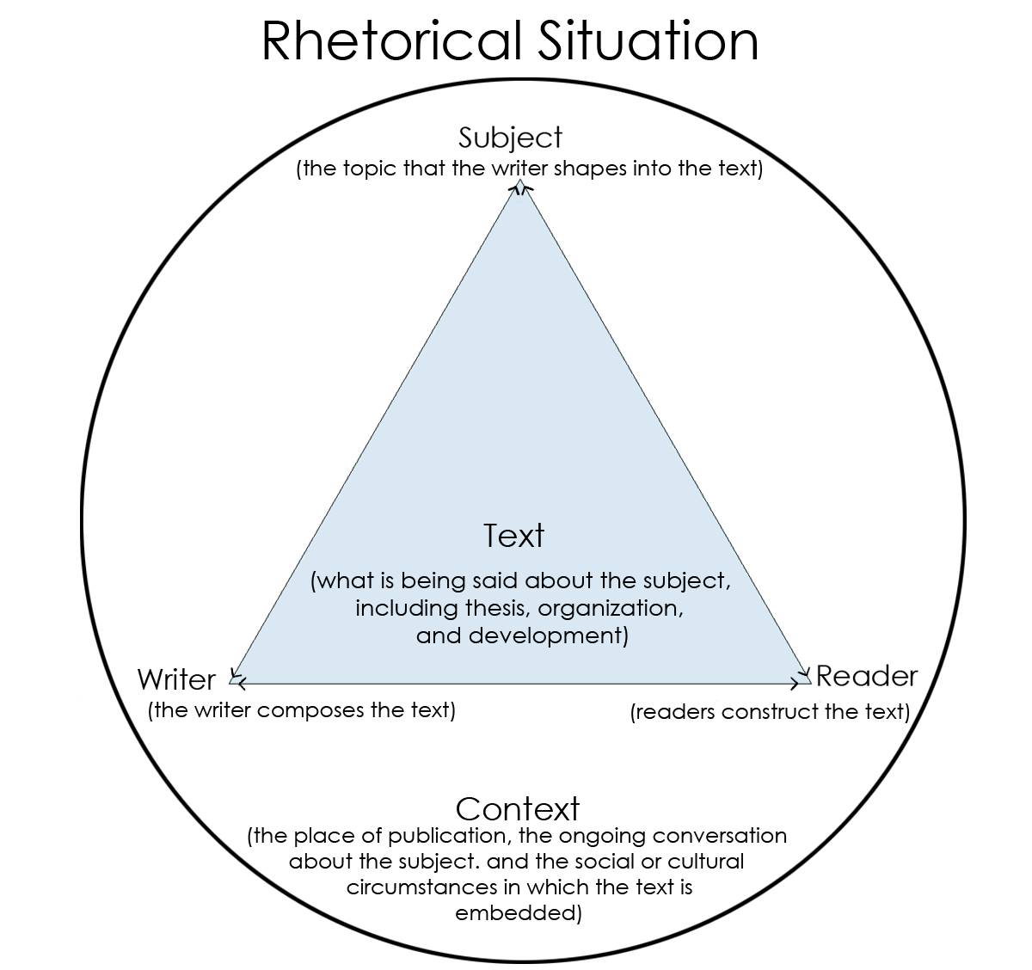
Analysis Essay - What is it?
To write an analysis essay, you need to think about how each part of something (novel and/or resources) contribute(s) to the meaning of the work as a whole (MOTWAAW) and/or supports your thesis claim.
You need to do your research and/or read the main text/novel and know the rhetorical situation (writer+subject & purpose+audience)

Slide 3
Analysis Essay - What is it?
NOOOOOO! Make sure that you're NOT just summarizing the original source, article, novel, or quotes. Go beyond simply telling us WHAT you are talking about.
YAAASSSSSS! Describe HOW and WHY resources/evidence functions. What is the resulting effect? How does it support your thesis claim??!

Slide 4
Analysis - a metaphor...
Summarizing = WHAT
Analyzing = HOW & WHY (BE SPECIFIC)
When you think about analysis, try thinking about how you might analyze a car.
Ask yourself: What do we want the car to do or accomplish?
Answer: (minivan) “provide transportation for my family”
Analysis: how does each part of the van achieve this goal?
Example: gasoline powers the engine
Answer: (sports car) “speed, agility, and style”
Analysis: how does each part of the sports car achieve this goal?
Example: light-weight construction enables speed

Slide 5
Analysis - Methods
Analysis research involves several steps:
Finding and collecting documents and/or READ novel/text.
Specifying criteria or patterns that you are looking for.
Analyzing documents for patterns, noting number of occurrences or other factors.

Slide 6
Analysis - Evaluate Sources & Text Evidence
Learning how to evaluate effectively is a skill you need both for your course papers and for your life.
You have to decide where to look (school databases are a great start), what clues to search for, and what to accept.
You will need to make decisions about what to search for, where to look, and once you've found material on your topic, if it is a valid or useful source for your writing and clearly supportive of your thesis claim.

Slide 7
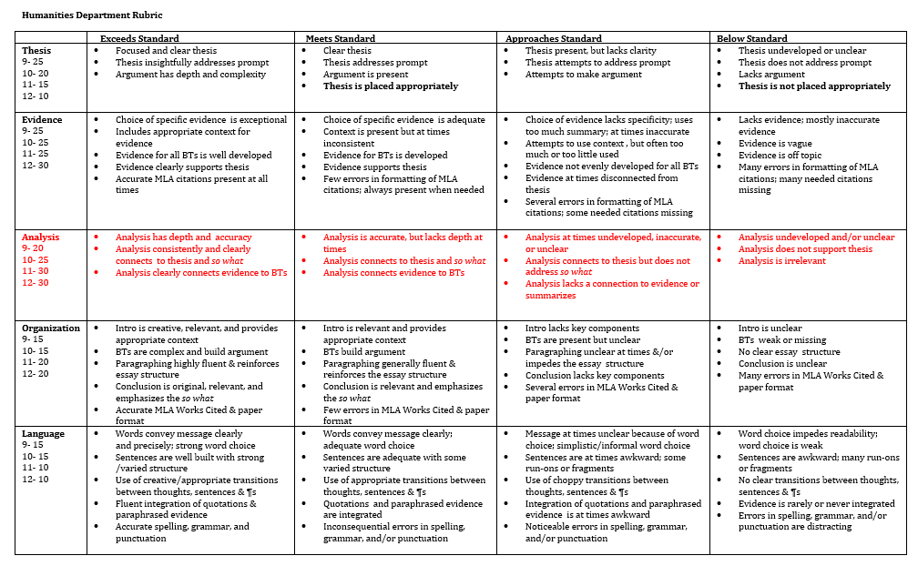
Analysis - SHS Humanities Rubric

Slide 8
Evidence - SHS Humanities Rubric - Exceeds Standard
• Choice of specific evidence is exceptional • Includes appropriate context for evidence • Evidence for all BTs is well developed • Evidence clearly supports thesis • Format: Accurate MLA citations present at all times for PARTIALLY INTEGRATED QUOTES.
SHS Humanities Rubric 2017-18 https://drive.google.com/file/d/0B-yxG_LkDfzRZVFMdVlVNGxhTlU/view?usp=sharing

Slide 9
Evidence - SHS Humanities Rubric - Exceeds Standard
-Biggest problem students have with the fall essay is evidence that only topically relates, but takes a BIG leap to link to the analysis Includes a setup (speaker & situation)
+Flows within sentence (alters quote if needed [ ] )
+Includes only what is essential
+Is integrated so as to eliminate redundancies
SHS Humanities Rubric 2017-18 https://drive.google.com/file/d/0B-yxG_LkDfzRZVFMdVlVNGxhTlU/view?usp=sharing

Slide 10
Analysis - SHS Humanities Rubric - Exceeds Standard
Analysis has depth and accuracy
Addresses nuances and effects. For LA, ⅖ BIG 5 suggested
focus stays on evidence quoted
Analysis consistently and clearly connects to thesis and so what
Analysis clearly connects evidence to BTs, which clearly connects to MTS.
SHS Humanities Rubric 2017-18 https://drive.google.com/file/d/0B-yxG_LkDfzRZVFMdVlVNGxhTlU/view?usp=sharing

Slide 11
Analysis - SHS Humanities Rubric - Exceeds Standard
LA specifically addresses 2 of BIG 5
SS/LA makes logical connections based on specific evidence used
Does NOT introduce new ideas that are NOT in evidence.
SHS Humanities Rubric 2017-18 https://drive.google.com/file/d/0B-yxG_LkDfzRZVFMdVlVNGxhTlU/view?usp=sharing

Slide 12
The Problematic
SS Thesis: The Edict of Nantes gave Huguenots numerous rights and privileges, redefining religious freedom by constructing an accommodative government that provides them with permission and resources to advocate their faith.
Evidence/Analysis: Wealth was given to Huguenots to build their churches, pay their preachers, as well as hold services. The First Warrant guaranteed the Protestants an annual pay of 4500 crowns, enabling them to grow their sect (Robinson). The Protestants being dependent on Edict of Nantes for support led them to be able to spread their religion and have a system almost as powerful as the Catholic Church itself.

Slide 13
The Good
SS Thesis: Thomas Becket’s death brought a newfound importance and figure into the religious lives of the English through the strong respect they held for his martyrdom, allowing religion to take a larger role in English society.
Evidence/Analysis: While the word spread of Henry’s connection to Becket’s death, he “was assailed by the execrations of almost all, and deemed fit to be the object of general detestation” as William of Newburgh stated (Stevenson). Henry’s association with the murder of Becket created a new reasoning for the Catholic citizens to question the king’s morals and motives, escalating the level of discontent they felt for secular power.

Slide 14
Evidence
When should you quote?
When should you paraphrase?
What do you have to cite?

Slide 15
Analysis - Macbeth Quote Analysis - What’s not/working?
1. LA PROMPT: Trace Shakespeare’s use of one of the following images (blood, sleep, hands, milk, birds, stars, dreams or night) and explain the significance of that image.
Shakespeare uses images of hands as symbolic of action, and in the case of the Macbeths, sinful actions. Observed while on a now-regular sleep-walk, Lady Macbeth obsessively exclaims that “All / the perfumes of Arabia will not sweeten this little / hand. O, O, O!” (5.1.53-55). Shakespeare’s hyperbolic exclamation “All” further characterizes the emotional distress that Lady Macbeth’s guilt has created, as she subconsciously recognizes that nothing can reverse her sin. Her final cry “O, O, O!” lets us know she is truly very upset.

Slide 16
Analysis - Macbeth Quote Analysis - What’s not/working?
5. LA PROMPT: To what extent does Macbeth’s duality between his internal/external persona cause his violent actions throughout play?
After publicly verbalizing his loyalty to King Duncan on the battlegrounds, Macbeth privately acknowledges that “[his] eye wink at [his] hand, yet let that be / Which the eye fears, when it is done, to see” (1.4.58-60). Shakespeare uses Act 1 to develop this tragically dual nature of Macbeth - a public persona that is looked upon with favor and a private persona that becomes corrupt with ambition. Hoping to be done with the murderous action within the blink of an eye, so as not to “see” the sin, Macbeth is characterized as morally corrupt in thought and soon-to-be deed. It is a rapid character progression urged on by Shakespeare’s urgent pacing...

Slide 17
Analysis - Macbeth Quote Analysis - What’s not/working?
6. Compare and contrast Lady Macbeth and Lady Macduff. How does this character foil contribute to Shakespeare’s message on femininity and womanhood?
Lady Macbeth & Lady Macduff are foils on most fronts, including that of motherhood. Shakespeare characterizes Lady Macbeth as currently childless, but willing to “dash[...] the brains out” of a nursing child if she promised her husband to do so (1.7.67). Such images of violence are used to highlight Lady Macbeth’s lack of feminine qualities, which further develop the unnatural state of affairs in the Macbeth household. In contrast, Lady Macduff is seen in a brief domestic scene in which she is engaged in a somewhat gentle dialog with her son about his now dead father. She uses terms of sorrowful endearment such as “poor bird” (4.2.40) and “poor monkey” (4.2.65), emphasizing her motherly nature towards her child. ...

Slide 18
Analysis - Macbeth Quote Analysis - What’s not/working?
See additional excerpts of analysis samples for review on handout

