Slide 1
Outlining
General Rules and Reminders

Slide 2
Purpose
The purpose of an outline is to get all of your ideas organized before writing the paper to help ensure
Your ideas are clear
Your sub-arguments are supported
Your argument is laid out in logical order
An outline is structure the BODY of your paper. Do not outline your introduction or conclusion.
Your research question and thesis statement must be at the TOP of your outline. Every part of your outline must connect back to your thesis statement.

Slide 3
General Outlining Format
All outlines should have the thesis as the first component.
Without the main thesis present, the rest of the outline has little meaning.
Introductions and conclusions are not a part of a formal MLA outline
You will only outline the BODY of the paper.
A formal outline has complete sentences for the thesis statement and the topic sentences
The other components of the outline should be complete pieces of information, but do not necessarily have to be in sentence structure.

Slide 4
The Format, a three-level outline
Research Question
Thesis
Title
I. First Level (body thesis)
A. Second Level (evidence)
1. Third Level (further evidence,context or connection of evidence to body
thesis – ie: analysis)
B. Second Level
1. Third Level
2. Third Level
C. Second Level
II. First Level
A. Second Level
1. Third Level
2. Third Level
B. Second Level
1. Third Level
2. Third Level
Citations at 2nd and 3rd level as appropriate
Every subordinate level must directly support the level above it.

Slide 5
Full Sentence Outlines
At the Roman numeral level (I, II, III, IV, etc.) of your outline (level one), you will have a full sentence
The Roman numeral levels of your outline are your body theses/topic sentences
These may or may not correspond to the paragraphs of your paper
You may have more paragraphs than Roman numerals this is because some body theses lend themselves to more than one paragraph of information

Slide 6
Full Sentence Outlines
The only complete sentences you must have are your body theses statements (BTS) / topic sentences (TS) and your thesis statement.
Topic sentences should be general enough to address ALL the information in the paragraph.
Your BTS must be an argument point. They also must have a DIRECT and CLEAR connection to your thesis.
Remember you are outlining the ARGUMENT POINTS of your paper not necessarily the paragraphs of your paper.
EACH ROMAN NUMERAL WILL NOT AUTOMATICALLY EQUAL ONE PARAGRAPH.

Slide 7
A Two-Level Outline (sample)
Marcella May
Ms. Maners
European Studies
1 March 2020
Evergreen versus Aloha
Is Washington really the best place to live?
The state of Washington is better than the state of Hawaii.
I. Hawaii is called the Aloha State and while there is much to appreciate about the area, it is a difficult place to live.
A. definition of Aloha (Smith 34)
B. positive attributes (there should be actual evidence here in your outline, ditto for all capital letters below)
C. difficulties
II. Washington has so much to offer and the mild temperature is very welcoming to exploring and adventure.
A. physical features
B. weather
III. The global location and proximity of Washington is much more convenient for traveling than Hawaii.
A. travel by car
B. air travel

Slide 8
What’s Due on Thursday, 11/1
You will have a typed three level outline. Include the following in your typed outline:
1) Full MLA Heading, Title, Research Question, Thesis at the top of the outline
2) Level One - Roman Numerals: Body Thesis (a complete sentence and be absolutely sure that this sentence directly relates to your thesis)
3) Level Two - Capital Letters: Think Evidence/Support/Facts (and be absolutely sure that the evidence relates to your body thesis)
4) Level Three – Arabic Numerals: Analysis (this should connect directly to your evidence and thesis)
Notes:
Outlines do not need to be double spaced
For all researched information – cite the source in your outline as though you are citing in an essay
You may include a works cited page for feedback for your editor, but note, this will be a requirement when your final paper is turned in.

Slide 9
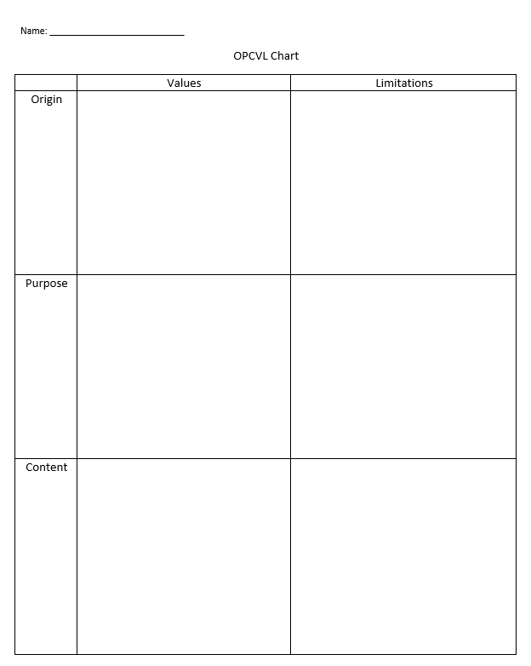
What’s Due on Friday, 11/2
Works Cited
This is NOT a bibliography
Transfer in to Word from Noodle Tools
OPVCL
Chart only (found on website) – do not need to write a paragraph – you will do that next year
Read extra handouts under “General Writing”
This is your first step in to this – ask questions!
Do OPVCL for 2 sources:
Your primary source or JSTOR source
One of your secondary sources

