Slide 1
Introductions & Conclusions
2018 Sophomore Project Essay – Maners/McGoorty-Morales Block

Slide 2
Introduction
Hook choices
Integrated Quote
Anecdote
Interesting Historical Content
DO NOT START YOUR PAPER WITH A QUESTION
Topical Introductory Content
Introduce the reader to the topic and the topic’s context in history.
Well-developed Thesis Statement

Slide 3
“The introduction and conclusion to a paper can be understood as a type of transition . . . At the beginning of a paper, the introduction serves as a transition by moving the reader from the world outside of your paper to the world within. At the end of the paper, the conclusion works in the opposite direction by moving readers from the world of your paper back to their own world ...” (Bacon 151)

Slide 4
Purpose of Introductions:
Hook (interest the reader whilst introducing the main idea)
Context (introduce the novel—by title and author—and summarize important information related to your thesis)
Thesis (state your argument)

Slide 5
INTRO. STRATEGIES:
HOOK
Anecdote, quotation, surprising fact, scenario, or interesting question
CONTEXT
Introduce the event/person/topic & summarize essential details (that the reader needs to know to understand your thesis)
THESIS
what + how + so what

Slide 6
Purpose of Conclusions:
RESTATE THE THESIS (reiterate your thesis using powerful word CHOICE)
synthesis (explain how your evidence fits together)
closure (transition the reader out of the essay)

Slide 7
CONC. STRATEGIES:
RESTATE YOUR THESIS
Review the “so what” component of the thesis – remind the reader what your point was
SYNTHESIS
Review key evidence by explaining how it connects together to fulfill a larger purpose
CLOSURE
Use a quote, scenario, an interesting question, make a connection, or bring your “hook” full circle

Slide 8
Samples
Look at Sample #1 & #2
Share with someone at table if needed
What is “good”?
What can be improved?

Slide 9
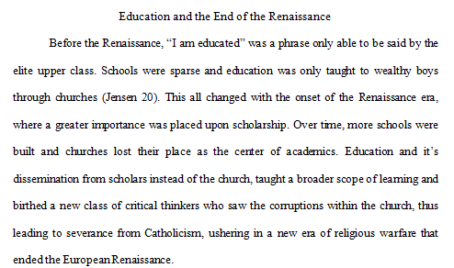
Sample #1 Introduction

Slide 10
Sample #1 Conclusion

Slide 11
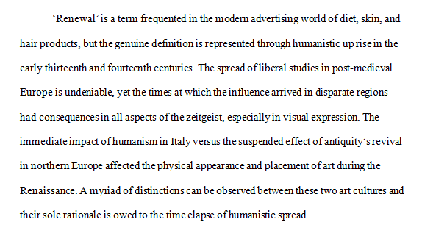
Sample #2 Introduction

Slide 12
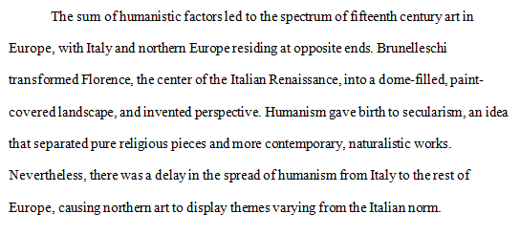
Sample #2 Conclusion

