Slide 1
Successful Quote Integration

Slide 2
How to integrate…
Something an author (or character) says, declares, etc.
If you are quoting anything the author (or character) says or thinks you need to have a comma immediately before the quotation.
Achebe insists, “It is an abomination for a man to take his own life” (Achebe 207).

Slide 3
Words to use other than “said”
writes
observes
notes
remarks
adds
declares
informs
alleges
claims
states
comments
affirms
asserts
explains
argues

Slide 4
How to Integrate…
Ideas in complete sentences:
When both sides of the sentence can stand alone, you must use a colon to present your quote.
Okonkwo killed himself because it was the only way he could fight: “I will fight alone if I choose” (Achebe 201).

Slide 5
How to integrate…
Partial ideas:
Integrate the quote fully into your own sentence by describing the subject in your own words and quoting the object (or action) of the sentence. No punctuation necessary.
Ex. 1
Okonkwo battles with his conscience as he “did not taste any food for two days after the death of Ikemefuna” (Achebe 63).

Slide 6
How to integrate…
Partial ideas:
Ex. 2
Okonkwo’s violence toward Ojiugo was a “nso-ani” and the rest of the village was horrified that he had “broken the sacred peace” (Achebe 31).

Slide 7
How to integrate…
Quotes in the wrong tense or partial quotes:
Use brackets to change tenses or reference subjects. Use ellipses to cut down quotes.
Dwight is a bully who takes out his anger and insecurity on those who are weaker than he is. While hunting, he boosts his ego by "kill[ing] anything he [sees]. He kill[s] chipmunks, squirrels, blue jays, and mockingbirds" (Wolff 171).
During their phone conversation, Toby's father tries to win Toby over by saying, "I've made some mistakes . . . We all have. But that's behind us. Right, Tober?" (211).

Slide 8
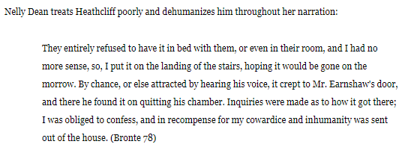
How to integrate…
Quotes longer than 4 lines (use sparingly):
Create a block quote by starting a new line of text and indenting the left side of the quote by ½ in. Your citation should come after the punctuation mark. Notice, there are no quotation marks.

Slide 9
How to integrate…
A quote within a quote:
Set off the inner quote with single quotations. If there is more than one quote within a quote, alternate between single and double quotations.
When Lena shows Ying-Ying around her new house, Ying-Ying complains that "the slant of the floor makes her feel as if she is 'running down'" (Tan 163).

Slide 10
Parenthetical Citations
Parenthetical citations are the simplest, most efficient way to cite ideas that do not belong to you, whether it be paraphrased or quoted directly
These citations happen most often in Social Studies. You MUST use direct quotes from the novel to prove your argument in LA.
Citations ALWAYS appear at the end of the sentence, even if there is information that appears after quoted material
There is NEVER any punctuation before the citation

Slide 11
How to Integrate…
Via paraphrasing:
Place ideas and/or events in your own words but include a parenthetical citation to indicate it came from the book.
Example: Okonkwo hanged himself (Achebe 207).

Slide 12
How to Integrate…
An epigraph:
Center the lines below your title (use double spacing below and above the epigraph)
Italicize the quote
Indent 1 inch on both sides
Use single spacing within the epigraph
Include the author’s name immediately below the epigraph, single spaced and on the right side of the text.
Create a corresponding entry in your works cited page.

Slide 13
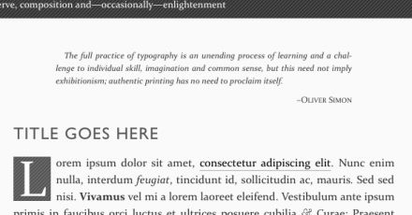
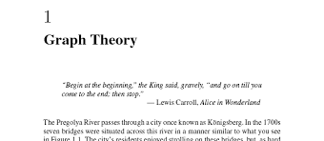
How to Integrate…
An epigraph:

Slide 14
How to Integrate: Analysis Focus
Your quotes will be stronger if you are focusing on a specific literary technique (connected to the how of your thesis). Avoid general analysis.
Focus your analysis around what the technique is doing, then tie it back to your thesis statement.
Thought process example:
Thesis how: characterization
Technique in quote: metaphor
Analysis:
First, how does the metaphor develop characterization?
Then, how does the characterization prove my thesis?

Slide 15
How to Integrate: Analysis Focus
What does this look like?
Shakespeare integrates metaphors into Lady Macbeth’s dialogue to portray her unorthodox attempts to gain power over Macbeth. After receiving Macbeth’s letter at the beginning of the play, Lady Macbeth exclaims, “Hie thee hither/That I may pour my spirits in thine ear/And chastise.../All that impedes thee.../To have thee crowned withal” (1.5.26-31). The metaphor of “pour my spirits” characterizes Lady Macbeth as manipulative and unnatural, whose ruthless ambition drives her to use her influence to poison her husband. The characterization not only shows both her sway over Macbeth and her control in the relationship, but her use of “spirits” also hints at unnaturality.
1
2

Slide 16
Now What?
Fix quote integration errors on the practice sheet provided.
Discuss the strengths of each analysis example. How does each create specific analysis that references technique?
Review your rough draft. Examine each quote for integration errors. How can you strengthen your quote analysis?

