Slide 1
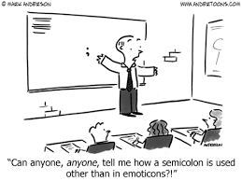
The Majesty of the Super Semi-Colon

Slide 2
Writing Lesson Objectives
Differentiate between the usage of:
The semi-colon
The colon
The comma
Write more formal, academic, complex sentences using the semi-colon

Slide 3
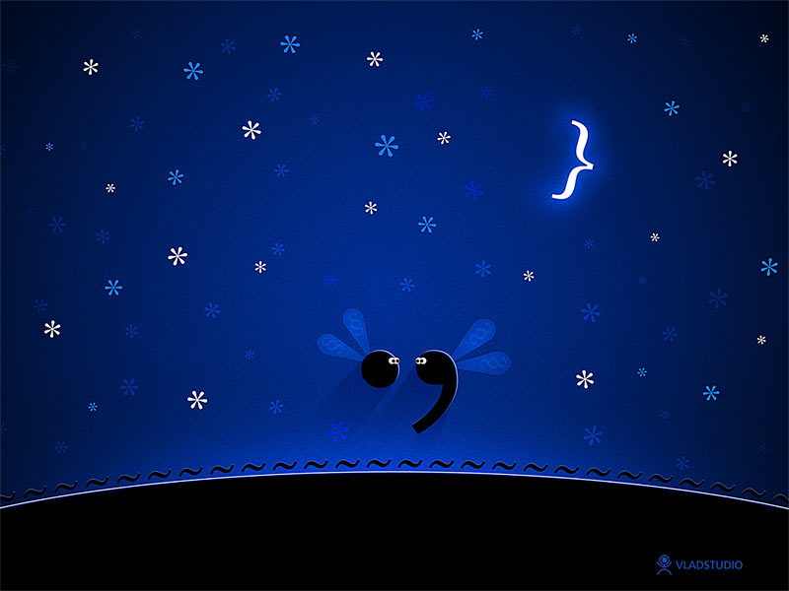
How the semi-colon came to be:

Slide 4
When writers use a ;
BOTH HALVES OF THE SENTENCE MUST BE ABLE TO STAND ALONE
It enhances a work’s complexity and formal academic style to combine short, related sentences.

Slide 5
Three occasions to use a ;
to replace a conjunction
before a transitional word
to avoid comma confusion

Slide 6
; to replace a conjunction
Goes between two related, complete sentences as a substitute for a regular conjunction (like “and” or “but”):
Romeo and Mercutio could not have stayed friends forever; they were both too stubborn and impetuous.

Slide 7
; before a transitional word
Is used before transitional words such as “however,” “therefore,” “still,” “besides,” “consequently,” “nevertheless,” “also,” or “hence”:
Myers wanted to be a good waiter; however, he talked so much that his customers starved to death before they could order.

Slide 8
; to avoid comma confusion
Break up fights caused by too many commas:
Free trips were offered to Corfu, the Greek Island; Morocco; St. Louis, Missouri; Elba, in the Mediterranean; and Paris, France.

Slide 9
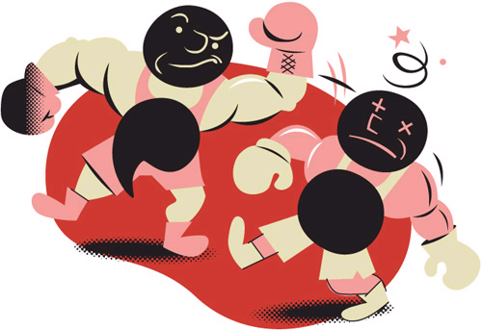

Slide 10
Colon :
Use a colon [ : ] before a list or an explanation that is preceded by a clause that can stand by itself.
There is only one thing left to do now: confess while you still have time.

Slide 11
Colon :
Use a colon [ : ] to introduce a quote.
Whitehead, speaking at Harvard, noted to his rhetoric students: “Style is the ultimate morality of mind.”

Slide 12
Colon :
Use a colon [ : ] in a title.
NEVER USE A SEMI-COLON IN A TITLE
EXAMPLES:
Frankenstein and His Creation: Humanity and Monstrosity
Frankenstein and Prometheus: The Peril of Ambition

Slide 13
Honors 10th Pitfalls: Beware the evil Comma Splice!
The comma splice inserts himself where semi-colons are required.
BAD EXAMPLE OF WRONGNESS:
The students looked strangely at Myers, they thought he had lost his mind.

