Slide 1
Transitions: The Glue That Holds Your Paper Together
And helps your reader follow the logic of your argument

Slide 2
Clunky / Artificial-Sounding: Avoid
First…Second…Third (or Firstly…Secondly…Thirdly)
Next…Then…Finally
For example
For instance
As an illustration
Obviously
Of course
As well (to start a sentence; ok in the middle)

Slide 3
Clunky / Artificial-Sounding: Avoid
Play specific transition statements:
Throughout history
At the beginning
At the end
Towards the end
Throughout the play/novel

Slide 4
Clunky / Artificial-Sounding: Avoid
To + a verb as a transition:
To begin
To illustrate
To continue
To follow
To conclude
To restate
To sum up
To wrap it up

Slide 5
Weak Concluding Transitions: Avoid
In conclusion / in summary
In brief
In closing
In short
All in all
In result
Overall
Wrapping it all up

Slide 6
Transitions
Establish logical connections between sentences, paragraphs, sections of paper
Key to good transitions: they highlight connections between corresponding paragraphs by referencing relevant material from previous ones
Often only takes a few words to draw these connections
Readers need stepping stones/sign posts to follow your logic
Weak transitions are those that do not clarify the logic of your argument

Slide 7
Examples
ORIGINAL:
She goes on to describe her actions, saying, “I washed thy face, but more defects I saw,/And rubbing off a spot still made a flaw” (13-14).
Bradstreet acknowledges that her child is helpless on its own and clearly in need of her help to attain the perfection she desires it to have.
REVISED:
She goes on to describe her actions, saying, “I washed thy face, but more defects I saw,/And rubbing off a spot still made a flaw” (13-14).
With words such as “defects” and “flaw”, Bradstreet acknowledges that her child is helpless on its own and clearly in need of her help to attain the perfection she desires it to have.

Slide 8
ORIGINAL:
The speaker uses sharp vivid words to convey a tone of shock at her house burning down.
From lines 44-48 the speaker describes a new house that God has constructed for her in heaven.
REVISED:
The speaker uses sharp vivid words to convey her shock at her house burning down.
This tone of shock contrasts with the tone in the final section of the poem where the speaker describes a new house that God has constructed for her in heaven.

Slide 9
Types of Transitions
Transition words or phrases:
All the way from “and” and “but” to “nevertheless” and “on the other hand”: but don’t just stick them in…make sure they clarify logic of argument
Repetition of key words and phrases: these can help the reader move from one paragraph to the next and one sentence to the next
Pronoun reference: pronouns naturally connect ideas because they refer to something earlier in the text.
BUT: it must always be VERY CLEAR what the pronoun refers to. Otherwise it is an UNCLEAR PRONOUN REFERENCE

Slide 10
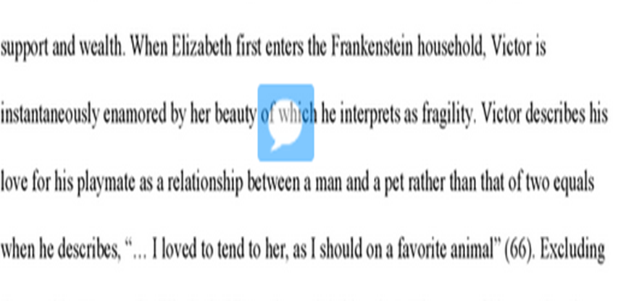
Transition Examples:
This example demonstrates an appropriate novel specific transition. Rather than the general, “At the beginning of the play”, this transition describes the specific context of the quote to set the reader up for analysis.

Slide 11
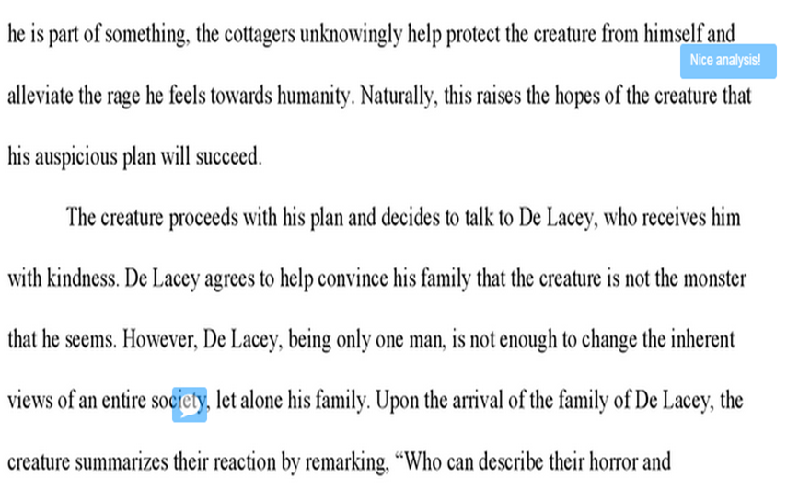
Transition Examples:
The repetition of the word, “plan” between paragraphs gives the reader “signposts” to follow the author’s thought without using clunky transitions such as “first” or “second”.

Slide 12
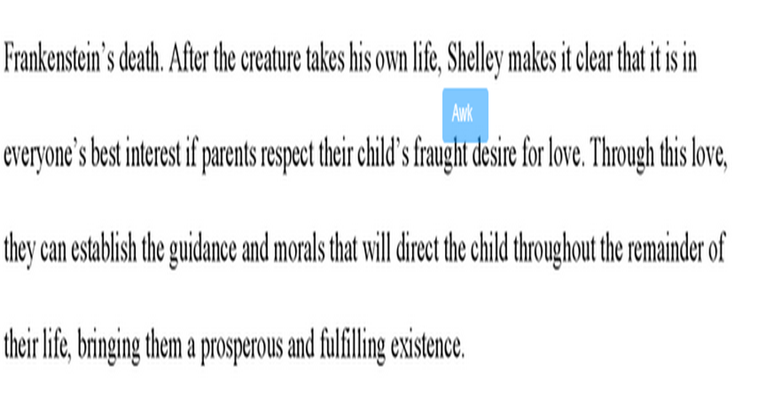
Transition Examples:
Key words such as “after” and “through” give the reader context for the analysis and connect the ideas within the paragraphs. Transitions are not only important between paragraphs, but also between ideas!

Slide 13
Just a few transitions that should be used sparingly and correctly: there are MANY more!
In addition
However
Indeed
Furthermore
Ultimately

Slide 14
NOW WHAT?
Using the examples on the practice sheet, highlight the words that allow the author to create great transitions. Discuss why these words work.
Then, look at your draft. Where can you implement great transitions?

