Slide 1
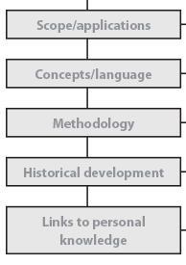
AOK Comparisons
For the 2 AOKs you selected for your essay…
Select one lens from the Knowledge Framework (other than Personal)
Using your own knowledge & the KFs in the IB TOK Guide 2015 explore the similarities & differences between the 2 AOKs
I have a class set of AOK KF’s to look at or you can find them online (but make sure they are IB’s)
Use something like the chart on the next slide to help you organize the information
Repeat above steps for at least 2 more of the lenses in the KF

