Slide 1
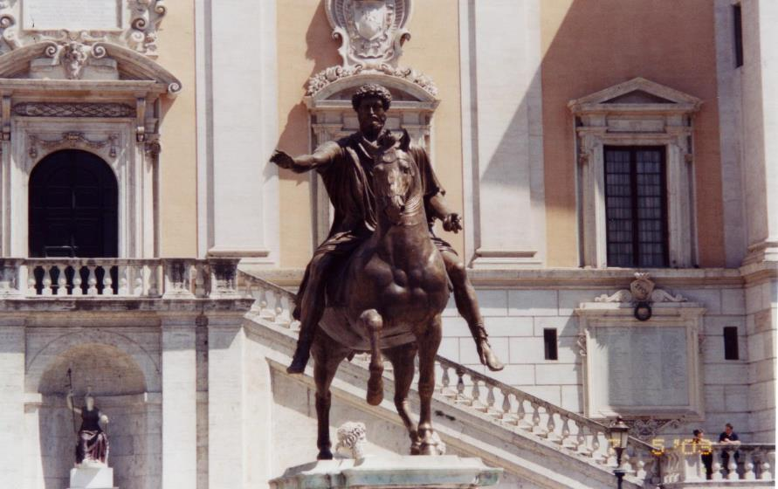
The makings of modern Europe & Latin America

Slide 2
Thesis
The turmoil caused with the fall of Rome led to a rigid hierarchical social system in which peasants routinely gave up multiple freedoms to be protected by the upper classes. Over the next several hundred years Europe & Latin America, once Europeans made contact, were in a constant struggle over the social & political rights of the class constructs since the fall of Rome. This manifested itself in a number of failed conflicts, which saw little gain for almost all social classes, but slowly eroded the system. The final manifestation of such was the beginning of free, modern social thought, constructs, & norms: the Enlightenment.

Slide 3
Part I: The turmoil caused with the fall of Rome led to a rigid hierarchical social system in which peasants routinely gave up multiple freedoms to be protected by the upper classes

Slide 4
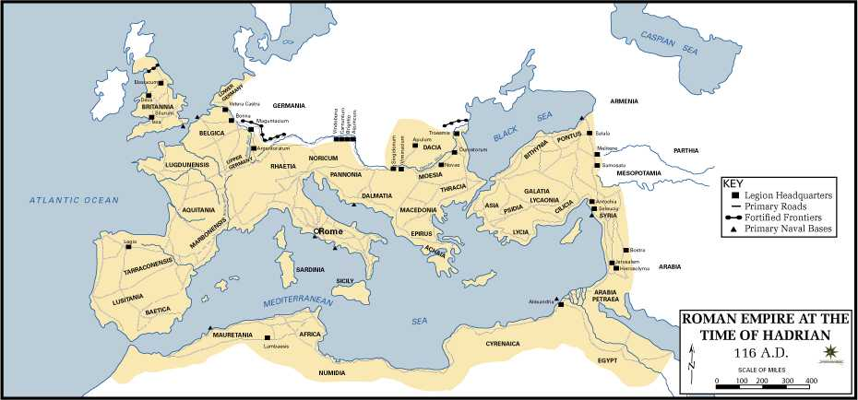
The Roman Empire

Slide 5
Side effects of the fall
Progress went backwards → people could see the old work but could not recreate it
General size and skill of life decreases
Trade disruption; loss of common currency
Decline of cities: population shifts out to regressive, agrarian society
Decline of arts and learning; loss of a common language
All this leads to a major, disunifying void → eventually this is filled by Christianity, socially
Politically there’s still a gap, which makes life very dangerous and leads to power for those who can fight → rigid hierarchy

Slide 6
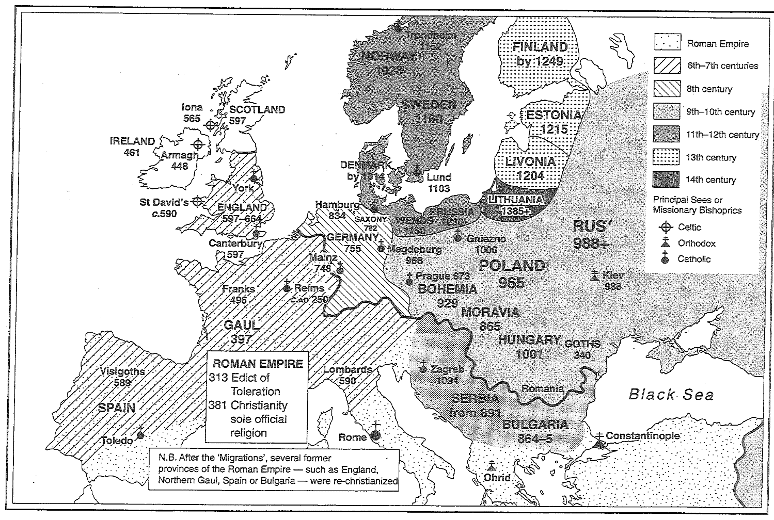

Slide 7
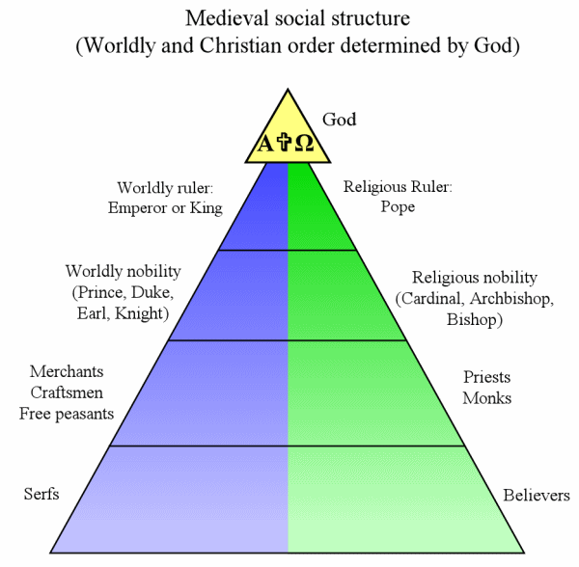
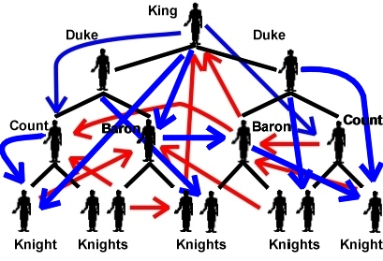
Feudalism
What feudalism is supposed to look like
What feudalism really looked like

Slide 8
Part II: Over the next several hundred years Europe and Latin America, once Europeans made contact, were in a constant struggle over the social and political rights of the class constructs since the fall of Rome.

Slide 9
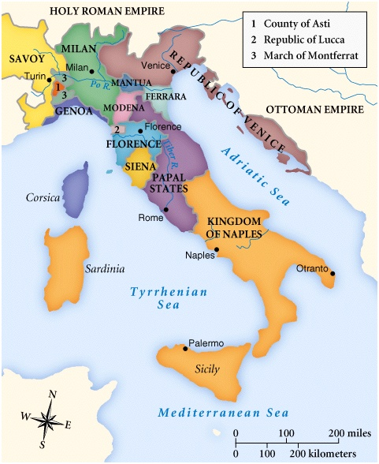
Renaissance 1304-1588
Begins in Italy
Marked by study of classics and move from god-centric to people-centric view of things know as humanism.
This did NOT mean a loss of religion
New focus on scholasticism and the individual

Slide 10
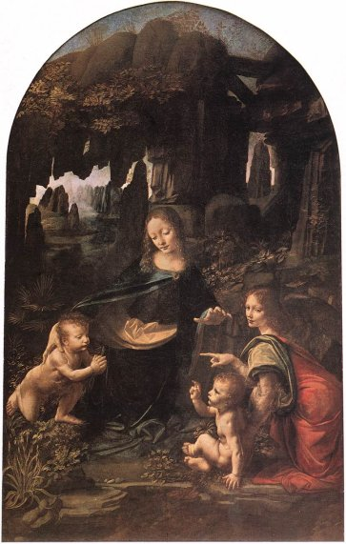
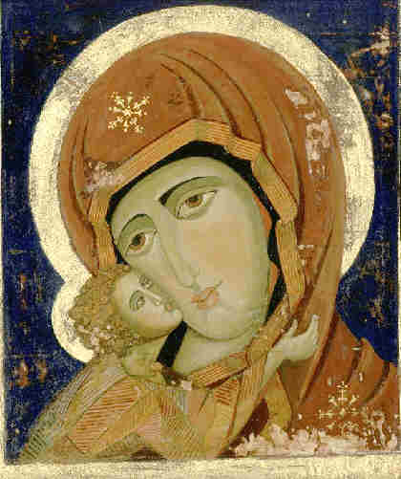
Renaissance Art

Slide 11
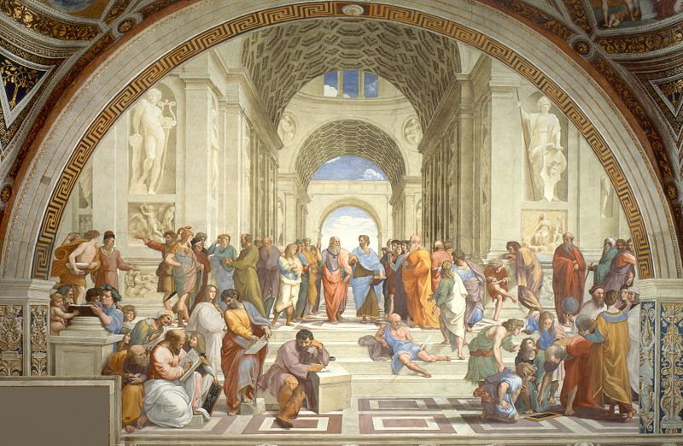
School of Athens by Raphael, fresco, St. Peter’s Basilica, 1510

Slide 12
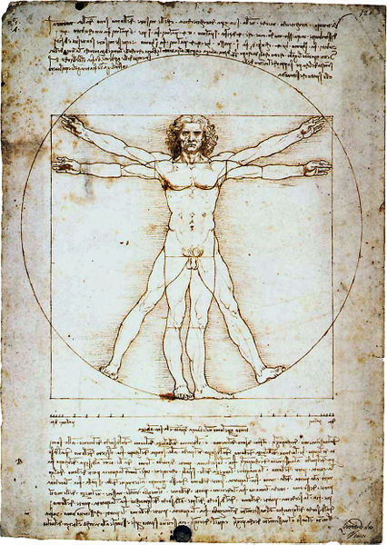
Vitruvian Man by Da Vinci, pen on paper, Galleria dell’Accademia in Venice, circa 1485-1487

Slide 13
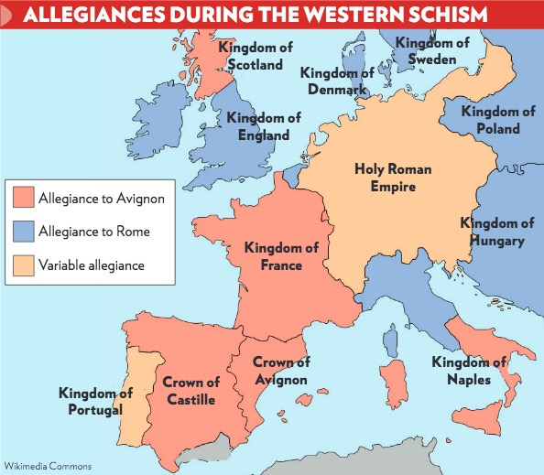

Slide 14
Printing
Arguably the single most important development in the history of Europe
Developed: Movable type by Johannes Gutenberg in late 1440s in Mainz, Germany, “imported” from China; Gutenberg Bible printed 1455.
The spread to rest of HRE, Italy, Low Countries and Britain
Works by having blocks of letters that you put in order, then ink and print
First printed advertisements seen in 1466
Allowed the masses to be educated, read, and form opinions—helps class mobility—greatly hurts priests as people begin to question wisdom and education of the church
Church was in charge of most education
Led directly to social upheaval in a massive, massive way, most notably the Reformation

Slide 15
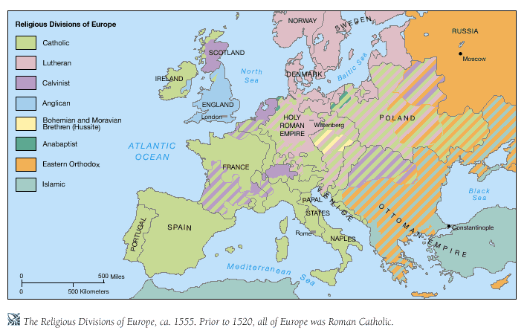

Slide 16
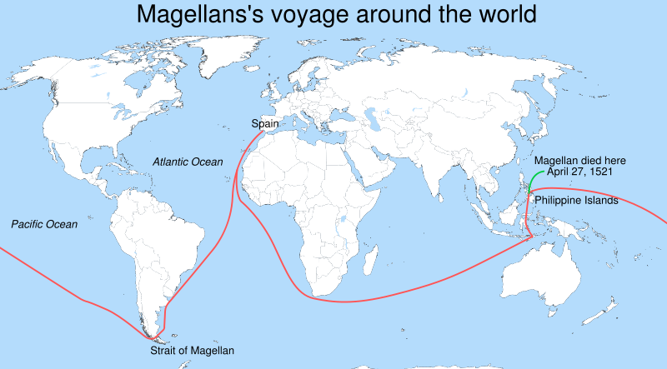

Slide 17
Spain & Portugal in the New World
Iberian conquest and governance of the New World was legendary for its brutality, absolutism, and horrific nature (cf. De Las Casas)
Triangle slave trade
raw materials to Europe; guns and gold to Africa; slaves to the Americas
Encomienda system
brutal, slave-based system based more on class status than economic viability
Honor system
emphasis on personal honor, respecting ones rights, duties and social role
Peninsulars vs Creoles vs mestizos vs natives
social pecking order: those born in Spain, Spanish born in the new world, those of mixed race, those of native race
Hegemony—tacit influence in a region or area (soft power)
Transculturation
blending of cultures to create new ones—i.e. Day of the Dead enters Christianity
Church and King had absolute authority on EVERYTHING and used the New World to make money

Slide 18
Part III: This manifested itself in a number of failed conflicts, which saw little gain for almost all social classes, but slowly eroded the system.

Slide 19
Sides in the Thirty Years War & 2nd Great Northern War
“Protestant”
“Catholic”
Prague (Bohemia)
HRE Protestants
Dutch Protestants (Netherlands)
France
Switzerland
Sweden
Denmark/Norway (for a bit)
HRE (German) Catholics
HRE (Austria) Catholics - Hapsburgs
Spain
Dutch Catholics (Belgium)
Denmark/Norway (for a lot)
Sweden (& Estonia and Latvia)
Lithuania
Prussia (for a bit)
Poland
Denmark/Norway
Russia
Prussia (for a lot)
Netherlands

Slide 20
The English Civil War (ECW)
Battle over rights of Parliament vs. role of the king
Parliament wins, Charles I ex. 1649
Hobbes vs. Locke debate
Results in English Bill of Rights, which is basis for liberties in US/UK

Slide 21
Impact of Thirty Years War & ECW
England establishes model for civil liberties in Europe
Establishes principal of ‘no taxation without representation’
Thirty Years War demonstrates the need for a Balance of Power in Europe
Wars of Religion begin to wane and politics become more important
25% of peasant population of Central Europe dead
Idea of Peace treaties rather than conquest and homage established
Swiss neutrality recognized; Dutch gain independence; HRE dissolves in all but name

Slide 22
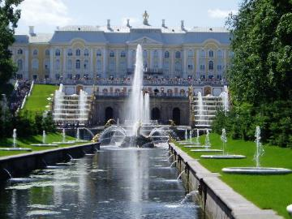
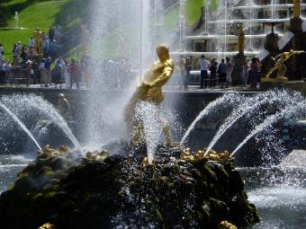
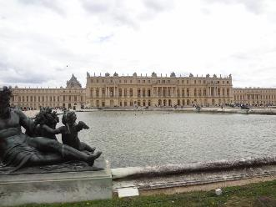
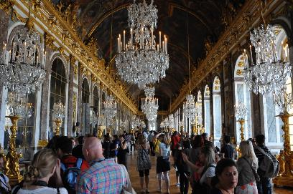
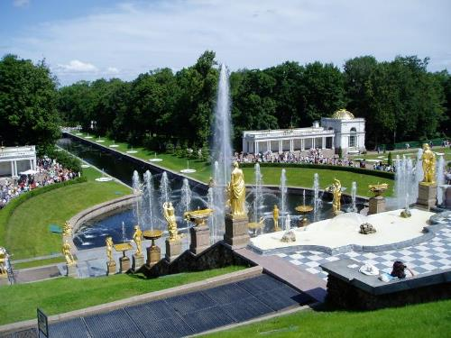
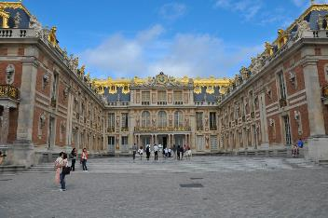
Absolutism: Louis XIV of France & Peter the Great of Russia

Slide 23
Tupac Amaru & other failed attempts
Series of minor revolts throughout Latin America in 18th century
Generally tend to be amongst oppressed workers, natives, or renegade early caudillos outside of cities
Sometimes put down, sometimes not, usually not a major threat till they disrupt the economy or impact cities
Most famous is Tupac Amaru II’s attempted revolt in modern Peru

Slide 24
Tupac Amaru & other failed attempts
Most famous is Tupac Amaru II’s attempted revolt in modern Peru
Amaru was descendent (maybe) of last Incan king, who rallied peasants, natives and lower class creoles in guerilla war
Betrayed & executed (in horrific fashion); led to series of laws by Spanish promising reform (but not delivering) and cracking down on native culture
Led to rebellion in New Grenada
Made Peninsulars uneasy & showed Spanish did not have absolute control

Slide 25
Gender & Power Jigsaw
Makings of a good jigsaw… what is the recipe for success?
Answer the following on a separate sheet of paper – include ALL group members names, only one copy per group, should have more than 1 writer:
What is the thesis of each reading?
How do the readings connect to yesterday’s homework and the Self-Reliance article? Summer reading books (can talk about either or both)?
What are common themes/ideas brought up in ALL of the readings (move beyond the given Gender & Power)?
Why would Ms. Maners focus on the role of women at this time?
Come up with one detailed, multiple choice question (options A-E) the incorporates multiple readings due today.

Slide 26
Part IV: The final manifestation of such was the beginning of free, modern social thought, constructs, and norms: the Enlightenment.

Slide 27
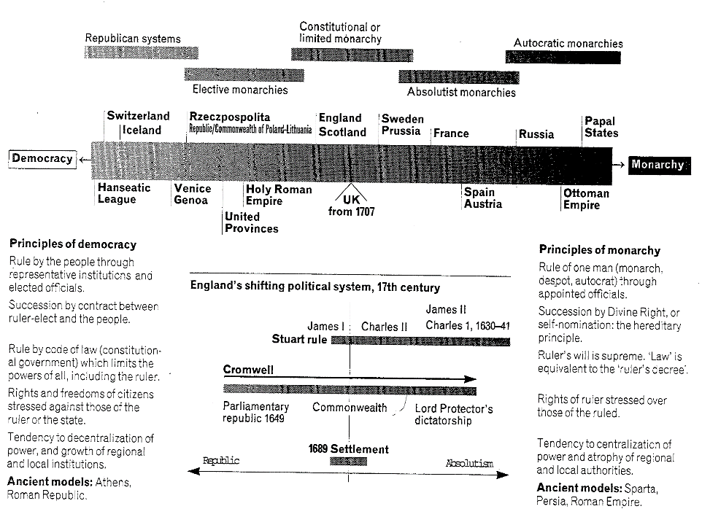

Slide 28
The Enlightenment

Slide 29
What does “The Enlightenment” mean?
 The Breakdown of the Enlightenment… 18th Century
Scientific Revolution
Enlightenment
French Revolution
 Everything can be explain through laws
Newton’s Law of Gravity = Society must have laws
State of Nature-good or bad = how to govern

Slide 30
The Philosophes
The group that “starts” the Enlightenment is the Philosophes
What is a Philosophe?
French term for philosopher, but not all French (most are) & not all just philosophers
Most all cover from upper and middle class
Writers, professors, journalists, economists, social reformers, politics/government

Slide 31
Philosophes’ ideas
Five main concepts behind their beliefs
Reason – truth could be discovered through logic or reasoning
Nature – what was natural was also good
Happiness – be happy here and now
Progress – mankind can always improve
Liberty – the French philosophes wanted the same liberties that the English had won through Bill of Rights, etc.

Slide 32
Philosophes’ ideas
Freedom of speech
Freedom of trade (economic freedom)
Freedom of religion
Freedom to realize one’s talents
Freedom to make your own way in the world
Many are Deists
God becomes the clockmaker
Universe is a machine with true laws (Newton)
God made it and then let it run
This shift allows the scientists to be right
Personally it allows for an explanation as to what bad things happen to good people

Slide 33
Common Words
Progress
Reason
State of Nature
Equality
Natural Law
Government
Sovereignty
Covenant
Social Contract
Civil Society

Slide 34
Machiavelli, Hobbes, Montesquieu, Voltaire & Rousseau discussion questions
1. Explain the key points made by Machiavelli and attempted to define the word Machiavellianism.
2. Discuss how the works of Thomas Hobbes built on the world-view of Machiavelli and Early Modern European politics.
3. Explain Montesquieu’s views on government.
4. To what extent are Voltaire’s arguments on tolerance in line with the ideas of the Philosophes?
5. Explain Rousseau’s thoughts on the social contract.
6. Outline the development of political thought in Europe based on the events discussed in the introductory lecture in the form of illustration.

Slide 35
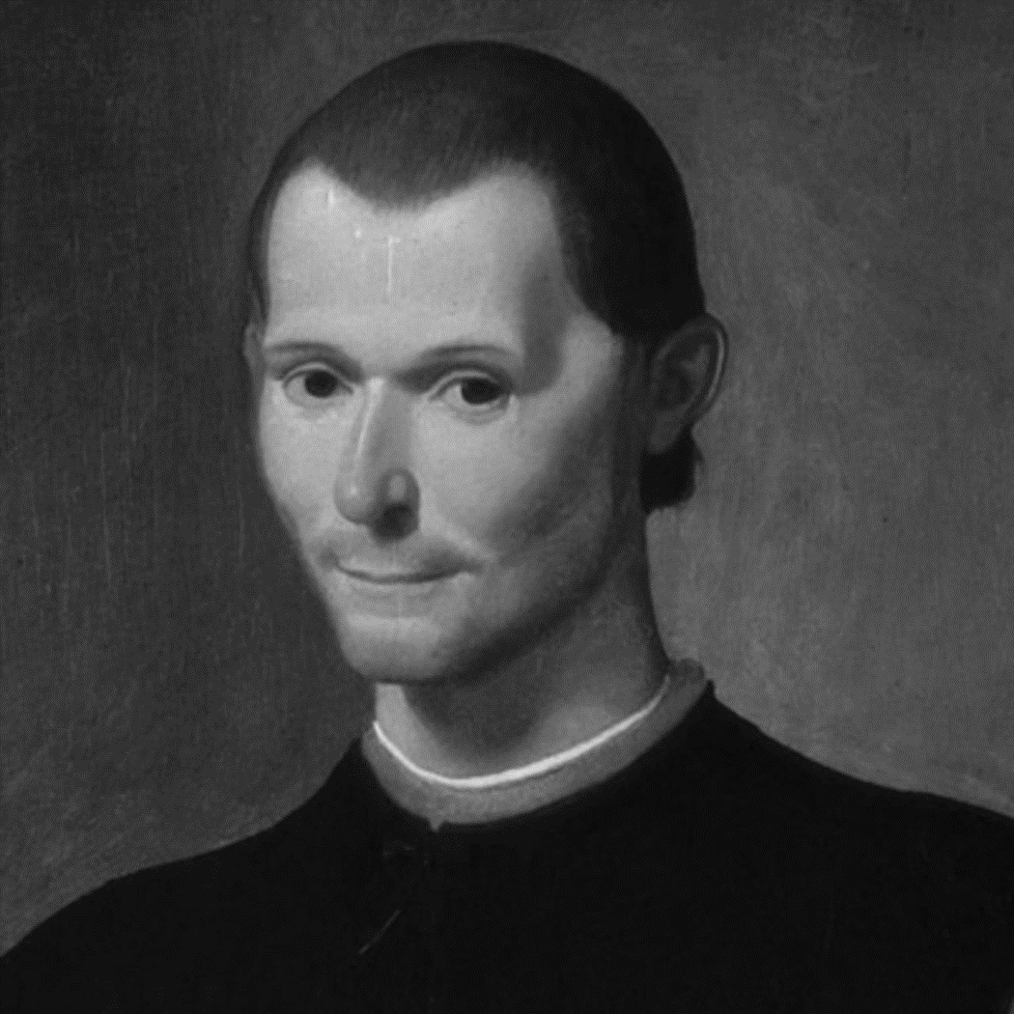
Machiavelli
What is different about Machiavelli?
Write Machiavelli’s thesis…
Machiavelli’s strategy to obtain and maintain power is made of many different steps
such as being loved by the people, but also feared;
understanding the people;
possess good qualities, or at least pretend they do.
The ends justifies the means…. What does this mean?
Where there is no court of appeal the end is all that counts
If the necessity arises he should know how to follow evil AND safer to be feared than be loved (ungrateful, fickle, and deceitful) – the threat of security will always win over love

Slide 36
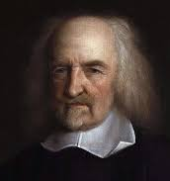
Thomas Hobbes
During Hobbes lifetime, political events in England were difficult and turbulent
Civil Wars of 1642-46 and 1648-51
Hobbes felt forced to leave the country (sent away – exiled) for his personal safety, and lived in France from 1640 to 1651
Wrote Leviathan while in exile and published in 1651
Even after the monarchy was restored in 1660, Hobbes's security was not certain
Hobbes's greatest fear was social and political chaos - and he had ample opportunity both to observe it and to suffer its effects.

Slide 37
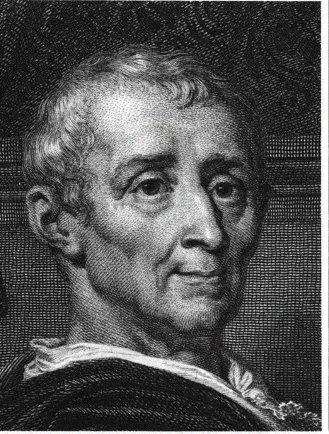
Baron de Montesquieu
Thought Britain was the best-run country on earth
King/Queen had executive power
Parliament had legislative power
Courts had judicial power
All worked in concert – well-balanced
Came up with the idea of checks and balances
One branch of government doesn't have too much power – is “checked” by another branch
Basis of United States Constitution

Slide 38
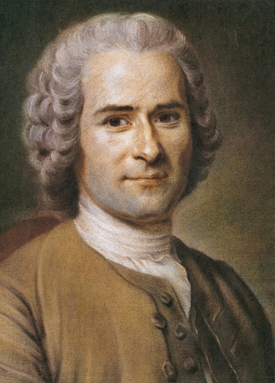
Rousseau
Believed civilization corrupted people’s natural goodness
The only good government is when people give up rights for the common good
His social contract was between people working together to create democracy
Similar to Locke, except Rousseau believed that all people were equal and wanted to abolish all noble titles
Eventually he is exiled for his radical ideas and spends the rest of his life moving from one refuge to another

Slide 39
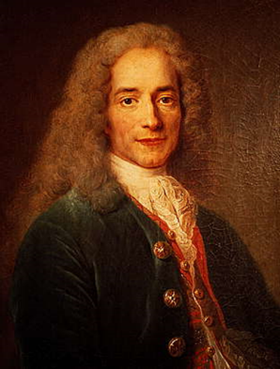
Voltaire
Most famous of the French philosophers
Used satire to make fun of “important” people
Satire – use of irony, sarcasm or wit to attack folly or stupidity
Was exiled for a time and was sent to jail multiple times for his sharp tongue
Quote: “I do not agree with a word you say, but I will defend to the death your right to say it” (didn't really say this)

