Slide 1
Key Aspects of an Industrial Revolution
A successful Industrial Revolution is a revolution categorized by five separate factors –
Entrepreneurs: You have to have people who want to take the risk of starting a business
Supply of Capital: In order to create, and run a business you must have capital (this is partially where the term you have to have money to make money comes from)
Resources: You must have some kind of resource (mineral, agricultural, etc…) in order to produce something (this has obviously changed but you still need resources)
Government: You have to have a government who is willing to let an entrepreneur start and run a company, this is not always the case (we will get to this later)
Market: In order to successfully create large companies they have to produce something that is either needed or desired, in other words you must have a market to sell your goods at

Slide 2
IR – Shift from England to Continent
Up to 1850 the IR has been (for the most part) in England
Between 1850-1871 the IR moves from the British Isles to the rest of the European continent
This is considered an age of economic prosperity for Europe (for the most part)
In the 1850s most of England was mechanized in comparison to the rest of Europe
The hand loom had all but disappeared in England and been replaced by power looms
In France alone there were still nearly a ¼ of a million
While this period of time does see a massive increase in textile production on continent, it is the railway that steams the IR ahead
You also see a massive increase in the production of iron on continent as well

Slide 3
IR – Shift from England to Continent
The next major factor that helps the spread of the IR and really allows for prosperity is the elimination of trade barriers
Danube (1857) & Rhine (1861) are declared freeways for all ships
Trade treaties in the 1860s (this ends in the 1870s) lowers/eliminates tariffs throughout much of Western Europe
Why is this going to help?
How is this a big shift?

Slide 4
IR – Adam Smith & Capitalism
Wrote The Wealth of Nations in 1776
Economic liberty guaranteed prosperity
Three natural laws of economics
Self-interest (People work for their own good)
Competition (Forces people to make better products)
Supply and Demand (Enough goods would be produced at a low enough cost to meet demand)
Laissez-faire (roughly) = “let people do as they please” = a core part of capitalism
Capitalism: Factors of production are privately owned and money is invested in those businesses to make money

Slide 5
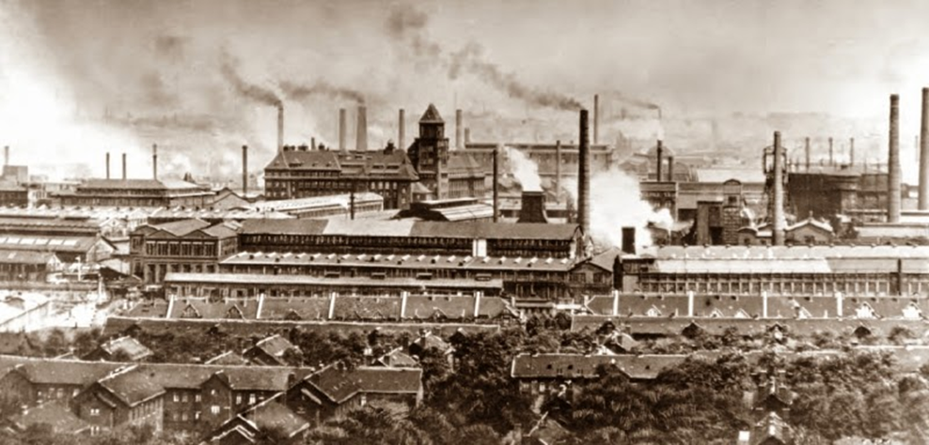
2nd Industrial Revolution
By 1871 most of continental Europe (still behind England) has been through the IR – At this point you see the emergence of the 2nd Industrial Revolution
In the 2IR the shift is from a rise in textiles, coal, iron, and railroads to steel, chemicals, electricity, and petroleum products
The first new technology to take off during 2IR is steel
Between 1860 & 1913 European nations go from producing 125K tons of steel to 32 million tons

Slide 6
2nd Industrial Revolution
Next are different chemicals
Soap, dye, etc…
Germany owned 90% of the market share by 1900
Possibly the greatest addition to come out of the 2IR is electricity
First used on a commercial level in 1870 in generators
By 1881 Britain has a power station
1910 the emergence of the first hydroelectric power stations occurs
Spawns a series of inventions
Light bulb – T. Edison & Joseph Swan in 1878-1880
Telephone – Alexander Graham Bell in 1876
Oh and every other thing that uses electricity you use today is spawned from this
The last major invention is the combustion engine in 1878
Used a new fandangled liquid to fuel it called petroleum

Slide 7
Turn and talk
Explain the social impact of the Industrial Revolution on Europe
Population growth
Emigration
Growth of cities
Urban living conditions
Early attempts at reform
Be prepared to share answers with class, will use cards
Take notes on student answers

Slide 8
The Working Class
Prior to the emergence of factories, and migration to the cities most people lived on small farms (we discussed this already)
Once they moved to cities and began to work in factories with extremely poor conditions This new lifestyle was vastly different for farmers
They were used to living and working odd hours
Now they would be put into a system that required them to adhere to strict working hours
This was a new challenge for both workers and employers, as this had never been done before

Slide 9
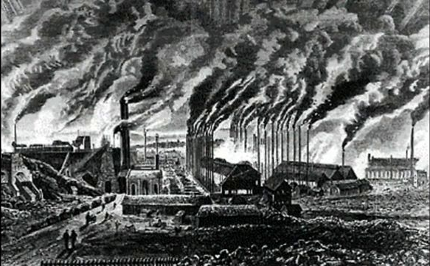

Slide 10
IR – Working Conditions Improve
Unions emerge –
Major thing to come out of early trade unions (around 1800) is that they were met with hostility from both businesses and the government and growth was slow
By 1900 over 2 million workers unionized in England
Unions existed for both men and women
All heavily influenced by Socialism, which we will get to
Unions inspired by Socialism

Slide 11
IR – Working Conditions Improve
1802-1819 – England limits what children can do in workplace, children under 9 were not allowed to work
1830s – Parliament starts to investigate child labor issues in mines
Factory Act of 1832
1842 – Women and children under 10 could no longer work in mines
Ten Hours Act of 1847 limited women and children to working 10 hours a day in factories

Slide 12
IR – Working Conditions Improve
Abolition of Slavery – Slavery existed in British colonies (but not Britain itself) – abolished in the empire in 1833
Some were morally opposed to slavery, others opposed it because they saw it as a threat to industry
Women’s rights – often paid 1/3 of what men were paid
Inspired by abolitionists’ work against slavery, women realized they could gain rights as well by protesting and striking

Slide 13
IR – Working Conditions Improve
Reform Act of 1832 –
Disenfranchised 56 slums near factories
Enfranchised 42 new towns and cities
Poor Law 1834 –
Attempted to help the poor and unemployed, made living conditions terrible so people would want to work

Slide 14
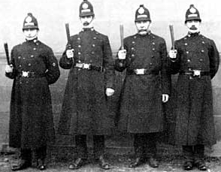
IR – Social Impacts
Emergence of police forces around 1830 in France/Britain
Also work as sanitation at times, clean up after drinking on the weekends
Spreads very quickly to other locations as a way to maintain control over mass populations

Slide 15
IR – Social Impacts
Concept of Mass Society emerges around 1870
Population increases in Europe from 1850-1910 from about 270 million to 460 million
Birth rate increases and death rate decreases = more people
Mass Emigration occurs
Between 1846 and 1932 about 60 million Europeans left Europe
Millions moved from country side to cities within Europe
For example between 1800 & 1900 London grew from 960K to 6.5 million

Slide 16
IR – Living Conditions
Public Health Act of 1875 – Prohibits the construction of buildings w/out running water and sewage
Sparks the construction of dams and reservoirs to get clean water to people & sewage removal
Sewage removal becomes the norm in the late 1860s
Much of the sewage is not properly removed, causes dirty lakes/rivers but helps in the cities
The use of gas and eventually electric heaters becomes common in the mid-late 19th century
Shower becomes common in the 1880s
Cities are redesigned – Walls removed, roads widened

Slide 17
IR’s – Impact on European Economics
By the 1870s many of the foreign markets are saturated with goods
From either their own nation or that have been imported from others
Nations begin to look inward to their own economies to develop larger market places
At this point European consumers are the richest in the world
During the 1870s there is an increase in the average amount of money Europeans make
As a result consumers in European nations have more money to spend on leisure goods

Slide 18
IR’s – Impact on European Economics
As more businesses arise during the later half of the 1800s competition rises with it
Businesses ultimately want to avoid free trade and governments put tariffs back on imported/exported goods
Why is this good and bad for European economies? European businesses?
There is also a rise in cartels (no not drug cartels)
A cartel is a grouping of enterprises that work together to fix prices and control output

Slide 19
IR’s – Impact on European Economics
Prior to the 1870s Britain had been the industrial leader of Europe
During the 2IR Germany overtakes Britain in production
Britain was filled with old factories and unwelcome to change and weary of new innovations
Germany is behind GB in the early stages of the IR, and uses the newest techniques and technology to catch up
This makes them more efficient in their production and allows them to overtake GB as the leading industrial power in Europe

Slide 20
IR – Impact on Government
Two major impacts on European governments
New and different forms of politics/beliefs became the norm
Capitalism (already covered)
Conservatism & Liberalism (already covered some, will continue to cover when talking Revs of 1848)
Feminism
Utilitarianism
Chartism
Socialism
Communism
Nationalism
We will spend the next couple of classes defining what these are and why the IR led to each of them.

