Slide 1
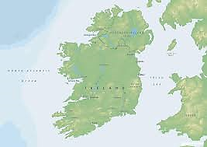
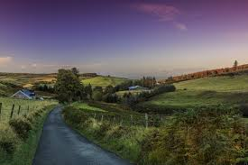
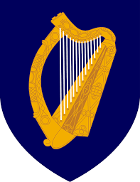
The Emerald Isle explained
(aka Irish history in 50’ish minutes)

Slide 2
Thesis
This lecture has no thesis because at the end of the unit on Ireland you are going to be asked to answer the dilemma: “Why did this Irish rebellion succeed?”

Slide 3
Plantation system
Begins during era of Tudors as England is fighting over religion between itself
Irish refuse to convert of Protestantism, remain Catholic → don’t help queen and go out of way to hurt monarchy
Elizabeth I begins system of Prot. English nobles resettling in Ireland (they were transplanted, hence the name plantation)

Slide 4
English Civil War & Ireland
Irish see English Civil War (1642-1651) as a way to get Catholicism back in the British Isles → side with Charles I against Oliver Cromwell
Once done with Charles, Cromwell gets revenge. Troops rape, pillage, and steal from Irish for months straight as Cromwell “reconquers” the country
Once he’s done, he moves even more of his Protestant nobles over to Ireland. They mainly settle in the north.

Slide 5
Orange Order & Battle of Boyne
William III comes to power in the Glorious Revolution → bloodless in England…
…but Ireland continues to fight since William III is Protestant
Comes to a headway at the Battle of the Boyne (1690)
William III and the Orange Order crush Irish Catholics

Slide 6
Irish Penal Laws
What were they?
Parliament/William take revenge on Catholic animosity.
Pass a series of Penal Laws which essentially relegate the Irish to 2nd class citizens
Causes Irish to rebel with alarming regularity
Stay in place for about 150 years until Daniel O'Connell

Slide 7
Daniel O’Connell (1775-1847)
Lawyer who worked for Catholic Emancipation and dissolution of Anglo-Irish union
Ran for Parliament and won, but was not originally seated because Catholics couldn't be seated in Parliament
Parliament realizes this could cause major, major issues and they agree to seat him
Held “monster meetings” or rallies against the Brits. until the Brits. banned them

Slide 8
Potato Famine 1845-1849
What was it? What is important to know?

Slide 9
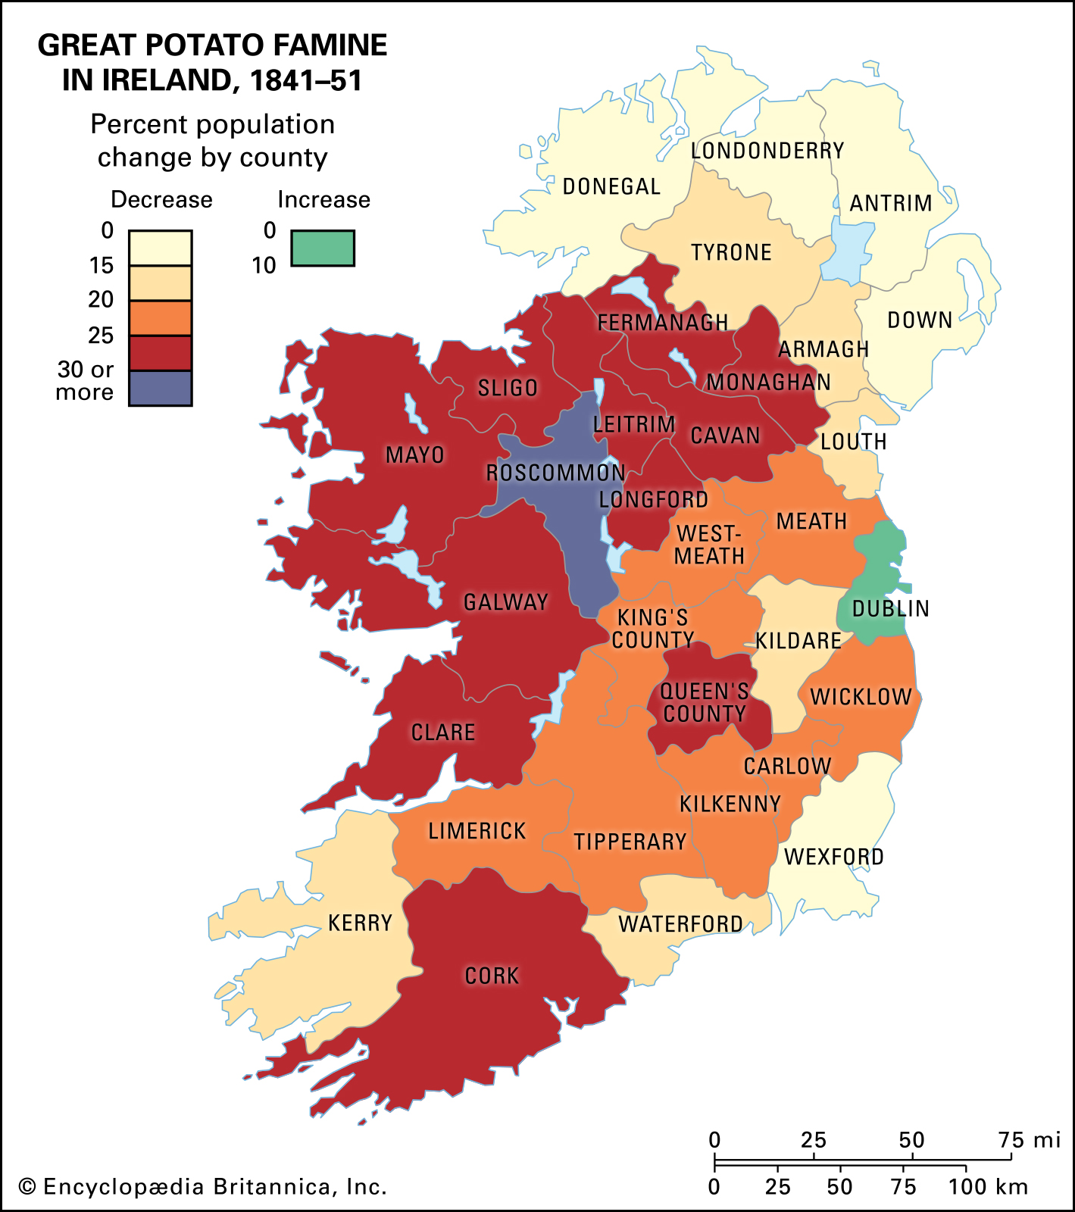

Slide 10
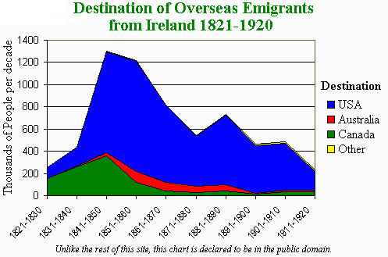

Slide 11
Charles Stuart Parnell (1846-1891)
Catholic MP in mid to later 1800s
Close colleague of Gladstone and massive advocate of “home rule”
Instrumental at the beginning of the IRB (Irish Republican Brotherhood) which led to IRA and Sinn Fein
Starts getting somewhere with home rule when one of the king’s important advisors is killed in Phoenix Park → aka Phoenix Park Murders
Brings Ireland/Britain closer together
Everything going well until sex scandal by Parnell

Slide 12
Easter Rising-April 1916
Ireland now more and more ready for Home Rule → Brits will give it to them until, WWI breaks out
Forces Parliament to put issue on back burner
Group of Fenians lead by Padraig Pearse storm General Post Office in Dublin and proclaim Republic → crushed by England
But English respond poorly by taking a while to execute the leaders & refusing them basic rights
Causes Irish to back Fenians and now its full scale rebellion time

Slide 13
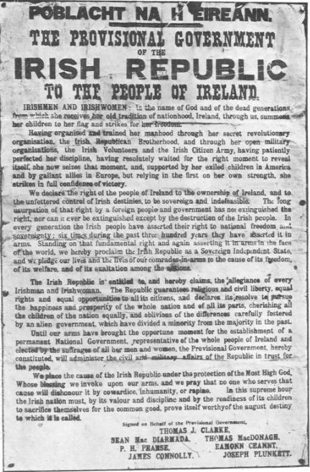
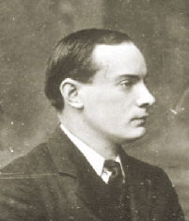

Slide 14
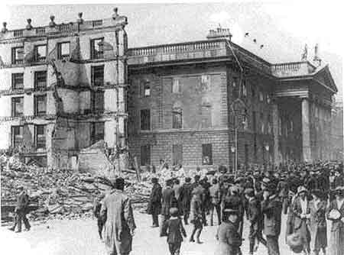

Slide 15
Anglo-Irish War
1918 Irish (illegally) seat first Dáil (Irish Parliament) which goes about trying to find a path towards Independence
At first peaceful, but then forms Irish Volunteer Army, which becomes Irish Republican Army (IRA)
Violent outbursts begin sporadically across the country → murders usually of British informants, government officials, etc.
Starts in full January 1919; lasts till July 1921
Big debate on whether to fight via guerilla or traditional warfare

Slide 16
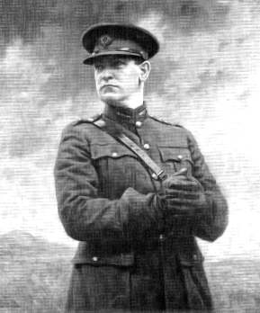
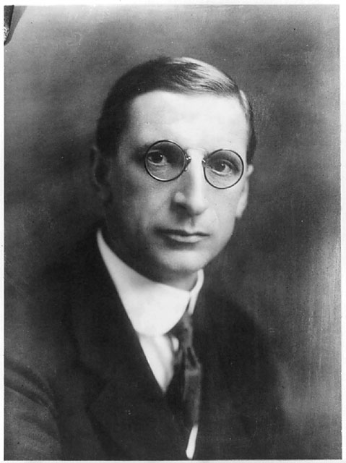
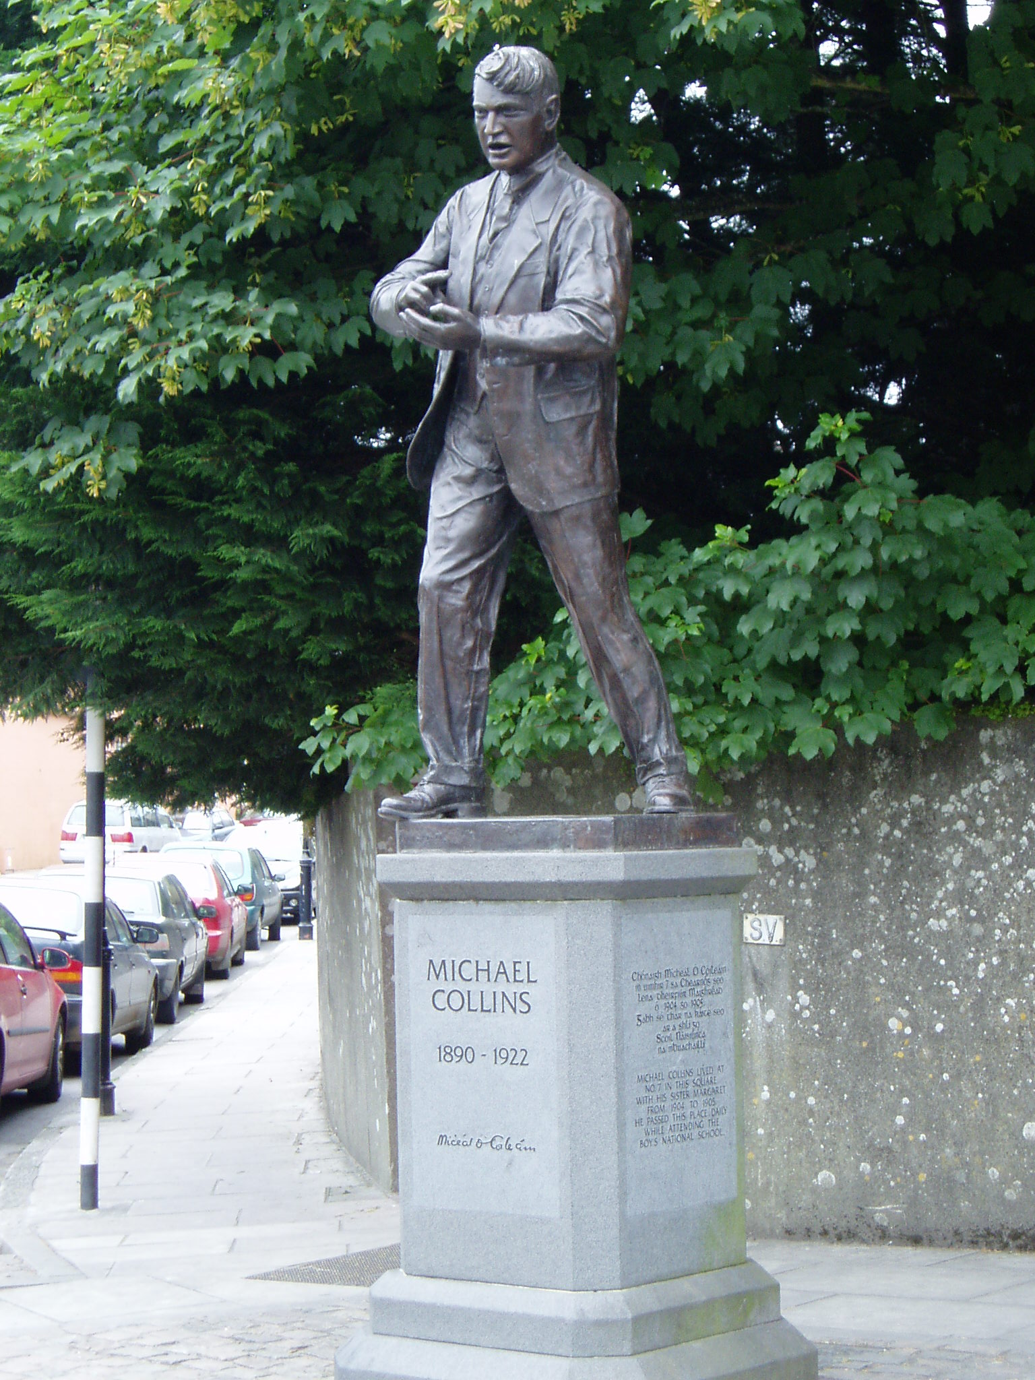
Eamon De Valera
President
(favored traditional warfare)
Michael Collins
Director of Intelligence
(guerilla warfare)

Slide 17
Collins vs. De Valera
Eamon De Valera (Irish President) believes that the only way the Irish can achieve independence is via a legitimate war and government and help from outside world (i.e. America)
Michael Collins (Minister for Information) believes that given Ireland’s lack of unity, training, men, and weaponry (and looking at the failures of past rebellions) a smash and run guerilla war is necessary
When Dev goes to jail, Collins wins out

Slide 18
The War 1919-1921
War success and failures are based around key assassinations, hiding out, and cooperation on the part of local population
When British retaliate it looks like atrocities (bad PR) to the rest of the world→Black and Tans in Cork
Collins works on intelligence: systemically orders the assassination of key British officials
Employs army of young men (IRA) and “terrorist tactics”
Climax is Bloody Sunday of 1920 when Collins’ men kill the 20 most important governing and intelligence officials of Britain in Ireland
Brits respond by driving a tank into the middle of Gaellic football match and opening fire on the players and crowd

Slide 19
Peace (kinda) Treaty
Brit (and world) public gets tired and Brits give up
Churchill (back from Gallipoli disaster) sits down with Collins & Co. negotiate peace treaty
Brits biggest concern in Protestant N. Ireland (and revenge fights after they leave)
Treaty breaks up the country with 26 counties in the south as Ireland and 6 counties in the north part of Britain
Collins signs the treaty and Dáil ratifies it, but Dev and his cronies refuse to recognize it and walk out, starting Civil War
IRA leaves Collins and goes to Dev’s side

Slide 20
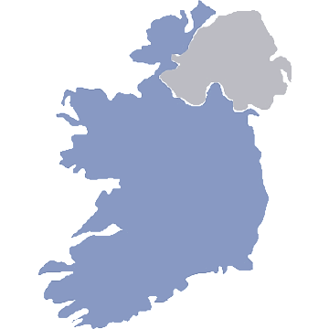
Protestant Northern Ireland (6 counties)
Now part of UK
Catholic Ireland (26 counties)
Now Republic of Ireland

Slide 21
Civil War & Aftermath
Civil War last for 11 months (6/22-5/23) Collins and pro-treaty forces win
Collins is assassinated (8/22) in Béal na mBláth; nation mourns him
Beaten, Dev’s forces give up and try to pursue goals through politics
Dev becomes 1st Taoiseach (PM) Irish free state lasts till 1937; break w/ UK via strongly worded letter
Some of the more violent, radical members take fight underground and create modern IRA which employs terrorist tactics against N. Ireland and UK
Fighting does not come to a full stop until the Good Friday Accords of 1998

