Slide 1
IR – Impact on Government
Two major impacts on European governments
New and different forms of politics/beliefs became the norm
Capitalism (already covered)
Conservatism & Liberalism (already covered some, will continue to cover when talking Revs of 1848)
Feminism
Utilitarianism
Chartism
Socialism
Communism
Nationalism
We will spend the next couple of classes defining what these are and why the IR led to each of them.

Slide 2
Guiding Questions
How do the changes in the 19th century create modern society?
How does the Industrial Revolution and the French Revolution foster the development of division between and/or creation of ideologies?

Slide 3
‘Isms-Reform Movements
Ism | Definition | Major Ideas & Texts | Today?
Chartism
Socialism
Communism
Conservatism
Feminism
Utilitarianism

Slide 4
‘Isms-Reform Movements
Ism | Definition | Major Ideas & Texts | Today?
Chartism | Achieve political democracy Universal male vote Annual Parliament | 1838-People’s Charter by London Working Men’s Asso. | Meh? Really 1838-1857
Socialism
Communism
Conservatism
Feminism
Utilitarianism

Slide 5
Capitalism, Socialism & Communism Economics Isms ISMs can be thought of like this… Which is more important: Liberty or Equality?

Slide 6
Capitalism – an economic system based on private ownership and on the investment of money in business ventures in order to make a profit.

Slide 7
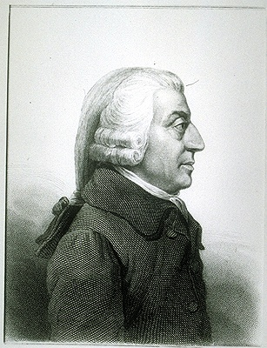
Capitalism
Maximizes liberty
Adam Smith – 1776 – “The Wealth of Nations”
“Free Enterprise” – everyone is free to pursue any economic activity, this will create progress
Laissez-Faire – do not interfere in the economy
Freedom to succeed and freedom to fail
Private ownership of capital (means of production)

Slide 8
Capitalism
Profit is the motivator, competition is the regulator (not government)
Under pure capitalism, almost all goods would be provided by the private sector (small government) – police, courts, military (even schools and the fire department could be private goods)
Do not tax the rich more than the poor – no redistribution of income
Good of the individual is above society
Law of:
Self Interest
Competition
Supply and Demand

Slide 9
Socialism – an economic system in which the factors of production are owned by the public and operate for the welfare of all.

Slide 10
Socialism
Mix of Equality and Liberty – came out of a belief in progress and social justice
Between pure capitalism and pure communism
Some private ownership and some public ownership of property
Some government intervention in the economy
Redistribution of income – high taxes on the rich to provide lots of government services
Examples of government programs like this in the USA?

Slide 11
Communism – an economic system in which all means of production are owned by the people, private property does not exist, and all goods and services are shared equally.

Slide 12
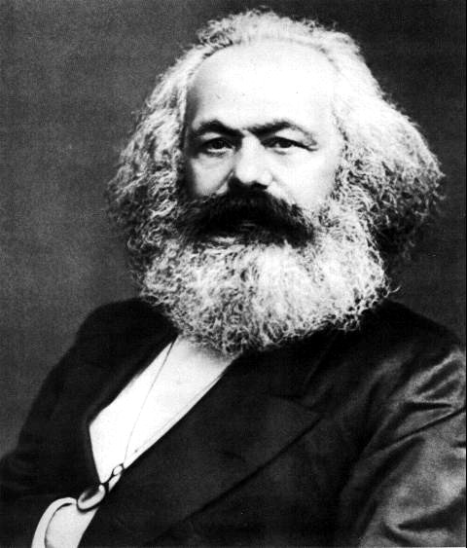
Communism
Maximizes Equality
Karl Marx
1848 - “The Communist Manifesto”
Industrial Revolution – Europe – horrible working conditions - critique of capitalism
I think 4 main ideas…
View of History – class struggle (bourgeoisie and proletariat)
Labor Theory of Value – all value comes from labor
Nature of the State – the state (government) always sides with the rich
Dictatorship of the Proletariat – poor must overthrow the government and set up a classless society

Slide 13
Communism
Public (government) ownership of the means of production
“From each according to his ability, to each according to his need.”
Workers run the factories – everyone earns an equal amount
Lots of government intervention in the economy to promote equality
Good of society is above the individual

Slide 14
Utilitarianism
Related to (but different from) capitalism
Called for the government to promote the greatest good for the greatest number of people
People should judge ideas, institutions, and actions on how useful they are, or their utility
John Stuart Mill was the most famous utilitarian philosopher → Called for government to end differences in levels of wealth in Britain

Slide 15
Feminism
Enlightenment (Mary Wollstonecraft)
New realizations of inequality in the 19th century because many women are now in the workforce (factories)
Focus is still family and marriage laws, but also starts to include…
More access to education and educational professions-opening up of many professions
Suffrage movement at the end of the century
“New Woman” – breaking traditional roles

Slide 16
Conservatism
Traditional conservatism, not like today
Reaction to the liberalism of the French Revolution
Monarchy, traditional, no sudden change
Large gov’t (today small government)
Edmund Burke
1790-Reflections on the Revolution in France
Pre 1830 - Metternich and the Congress of Vienna, then the Concert of Europe
Legitimacy
Balance of Power
Principal of Intervention

Slide 17
Revolutions of 1848
Can you answer the following based on the CR:
What are the goals of the revolutions across Europe around 1846-48, what are some common themes amongst the revolutions?
Some historians say the “failures” in 1848, why?
In reference to the Revolutions of 1848, historian A.J.P. Taylor noted “history reached a turning point & failed to turn”. Discuss to what extent you agree with this statement.

Slide 18
Conservatism
Taylor - “history reached a turning point & failed to turn”
Starts in France
IR Impact
Class identity
Living closer together in major cities
Spreads to other countries
Concert of Europe
Conservatism, slower-controlled change
Initial Gains
Ultimate defeat, for now…

Slide 19
Revolutions of 1848 “history reached a turning point & failed to turn” - A.J.P. Taylor
1846/1847 – France
Problems?
New Napoleon?
Prussia
Problems with big and little Germans
Results?
Austria
Diverse empire (strict control)
Hungarian gains… er, wait… what was that? Why would Russia aide Austria?!?
Italy…

Slide 20
Zionism
What was the most interesting aspect of each that you learned in the reading?
Is this still an issue today?

