Slide 1
Think & discuss
Think about the last unit…
What happened in Mexico in the 1800s?
What is happening in Latin America during the IR & late 1800’s?

Slide 2
Review
Mexican Independence (Hidalgo & Morales)
Rise of caudillos (Santa Anna)
Mexican-American War
Benito Juarez & liberalism
Mexican Civil War
Neocolonialism (US & European intervention) = foreign corporations in Mexico
Great Export Boom = massive discrepancies in land distribution
Social Darwinism

Slide 3
Neocolonialism
Limits:
All this hurts the small farmers who are now being forced to sell or being kicked off their land to make way for both commodities & Progress
Example: by 1910 only about 3% of Mexicans actually owned land
Forced into small sharecropping farming
Indigenous people who had fled from Europeans into the inner territories, also evicted
Countries often set up favorable tax systems to attract international corporations, hurting the poor & forcing them to pay higher taxes to compensate – i.e. Banana Republics
All this dovetails with Victorian values or gender roles, as well as new ideas like Social Darwinism…

Slide 4
Mexican Revolution Background
Take a few notes on…
Causes of the Rev.
Key Figures
Goals of the Rev.
Dates/Timeline

Slide 5
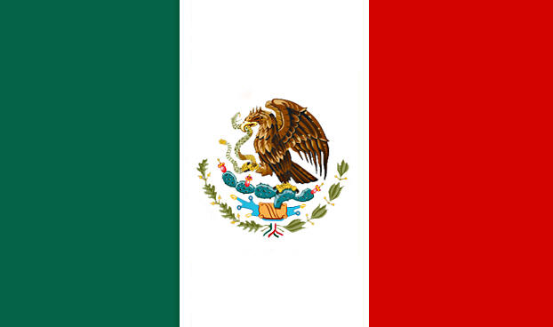
The Mexican Revolution to Madero

Slide 7
Thesis
The effects of Progress & Great Export Boom led to massive inequities in Mexico in the early 20th century; &, the rule of neo-caudillo Porfirio Diaz only exacerbated the problem, leading to unrest & revolution. However, the country’s difficult terrain coupled with multiple regions & personalities, led to disunity amongst the masses and those trying to lead them. With the distrust that remained from the Diaz administration, no one could take control of Mexico & have the backing of all the people, leading to unrest, revolution, & civil war.

Slide 8
Post-Juarez Mexico & the rise of Diaz
After expelling the French and executing Maximilian I, Juarez rigged elections to remain president, trying to push a liberal agenda with little success
Died of a heart attack and was succeeded by Sebastián Lerdo de Tejada (Lerdo laws)
Lerdo rigs his re-election and decentralizes the government
This does not lead to the promised land reform
Porfirio Diaz cries foul and stages a coup; overthrows Lerdo in Battle of Tecoac (Lerdo runs to NYC) and eliminates his other rivals to become President

Slide 9
Porfirio Diaz
Diaz is almost like a neo-caudillo
Very popular amongst people at first because he is a Catholic, military man (won cinco de mayo) who promises reforms
Instead gives most of land to his men and other rich creoles & become corrupt:
Elections becomes more blatantly rigged than before
Eliminates freedom of the press and of speech
Imprisons political enemies or executes them after show trials
Allows the church to reclaim land, etc.
Forces local governors to kick-up lots of money to the national state

Slide 10
Porfirio Diaz
But, he looks really, really good to the outside world – why?
Mexican exports increase a lot (trade grows 900%) during the Great Export Boom;
Industrialism & infrastructure improvements occur
Allows US, British & other corporations to come into Mexico to produce & export raw materials
Tries to make Mexico City as European (and civilized) as possible

Slide 11
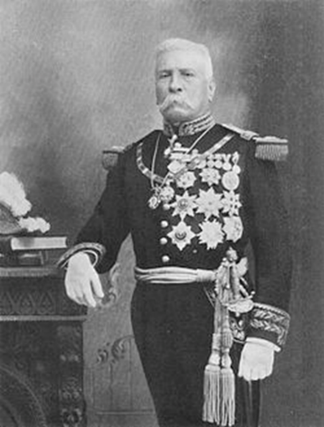
Problems with Diaz’s rule
Main Problem: None of this trickles down to the lower classes→3% of the population owns 100% of the land
Lower classes essential toil as some version of serfs/sharecroppers
Diaz even reapportions land given as a reward for military service & land given to indigenous people

Slide 12
Problems with Diaz’s rule
Wages are far too little
Foreign corporations come in and “steal” more land
Pandered to by gov’t who gives them takes breaks and doesn’t oversee working conditions; in return they line the pockets of Diaz & his cronies
At height, foreign corporations make more money than rest of Mexican GDP
All the while, paying horrible wages
Kids have to start working by age 7/8 in order to be able to feed family
Bottom line: people are getting hangry

Slide 13
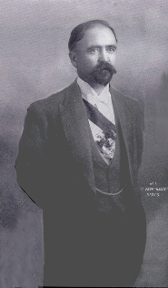
Rise of Madero
June 1, 1906 Mexican workers at an American owned copper company go on strike
Workers elect delegation to negotiate, company refuses, workers storm the gate killing two Americans
Diaz allows US Rangers to come in a put it down
Very unpopular with Mexicans of all classes
More strikes follow with brutal repression
Sensing unrest, Diaz promises to finish out his term and retire with election of 1910

Slide 14
Rise of Madero
Urged by this, a rich landowner Francisco I. Madero publishes a book La sucesión presidencial en 1910 which lays down the problems with Diaz and a military dictatorship
Madero tours Mexico planning to run for President
Diaz changes his mind, and tries to run for a 6th term, just to make sure it work, he imprisons a bunch of Madero’s follower and then Madero himself on election day
Diaz then claims victory saying he got all but about 200 votes

Slide 15
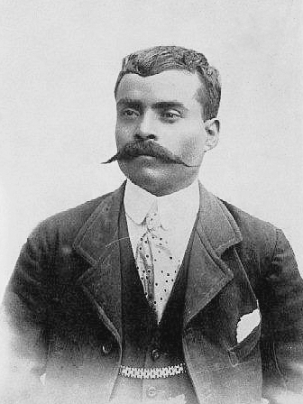
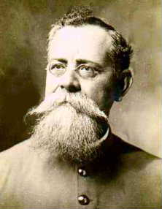
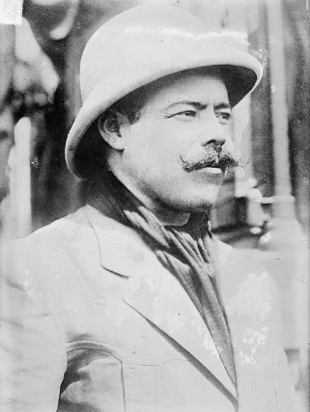
Zapata
Carranza
Villa

Slide 16
Villa, Zapata, & Carranza
Diaz plans election victory party and the amount spent plus the disparity between those involved is massive
Ex: cost is higher than country’s whole education budget while 85% of country is illiterate, etc.
Madero escapes from prison and makes his way to the US where he challenges Diaz publically
Done in San Antonio, called Plan de Dan Luis Potosí
Calls on all of Mexico to rise up at 6pm on 11/20/1910
Mexico guerilla forces start to rise up and rebel-all of the country
In the Northwest, a bandit Pancho Villa unites the forces
In the South a poor worker Emiliano Zapata unites the forces
In the Northeast the local governor Venustiano Carranza unites the forces
All three begin taking strategic towns and working towards Mexico City; none of them are actually working together or directly with Madero

Slide 17
End of Diaz & beginning of democracy?
As Villa takes over the North, he invites Madero back to set up a provisional government
None of the men really trust each other and the peace is tense (they point guns at each other a few times during negotiations
Realizing he was surrounded (and wanting to get out alive) Diaz resigned on May 25 and goes into exile in Paris
Madero makes his way to Mexico City via train and is greeted as conquering hero
Meets with Zapata and rebels in the South who cautiously accept him as President

Slide 18
Development of the MR
Why does democracy fail under Madero?
How does Madero deal with land issues when he takes control?
Do workers get more rights?
What happened with education reform?
What was the deal with all the revolts under Madero?
Who was Huerta?
What was the 10 tragic days? – Decena Tragica
How does the role of the US factor in to the revolution?
What was the impact of the Constitution of 1917? Impact of the revolution overall?

Slide 19
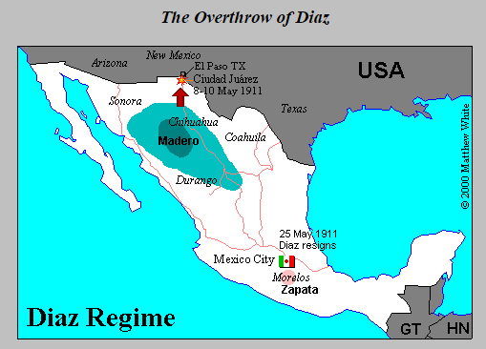
Overthrow of Diaz
http://users.erols.com/mwhite28/mexico.htm

