Slide 1
1. How do the changes in the 19th century create modern society? 2. How does the Industrial Revolution and the French Revolution foster the development of division between and/or creation of ideologies?

Slide 2
Nationalism
An Introduction

Slide 3
Europe Thesis
The new unification of the working class, coupled with conservative reforms of the Congress of Vienna, led to a new unity within the oppressed classes. This coupled, with the Industrial Revolution caused the lower classes to form an adversarial relationship with the “fat cats” of capitalism. As a way to reclaim power the lower classes rallied around the new idea of the nation-state causing an outburst of Nationalism and eventually resulting the unification of Italy and Germany.

Slide 4
Nationalism
Nationalism is the belief that people’s greatest loyalty should not be to a king, but to a nation of people who share common history and culture
Nationalism blurs the lines in political spectrum
Invokes all parts of life: Culture, History, Language, Territory, Nationality, Religion
Series of “isms” cause a major increase in nationalism, beginning w/ Rev. of 1848
Most involved major shift to left in political spectrum

Slide 5
Nation-state
When a nation, a group with a common culture or history, has it’s own independent government, it is called a nation-state
You can have nations without states (i.e. no government like Egypt, Libya, Liberia) and states without nations (i.e. no common land like Palestine, Poland 1939, Baltics during Cold War)
In 1815, only a few nation-states existed in Europe.
Britain, France, Sweden, Spain, etc.

Slide 6
Mazzini On Nationality
According to Mazzini – what is nationalism (give total definition)?
Paraphrase his ideas
What is Mazzini’s argument? How does he lay it out?
Paraphrase and find quote(s) to support it

Slide 7
Revolutions of 1848
Talk with your table mates about the following:
What are the goals of the revolutions across Europe around 1846-48, what are some common themes amongst the revolutions?
Why does Spielvogel feel as if there are “failures” in 1848?
In reference to the Revolutions of 1848, historian A.J.P. Taylor noted “history reached a turning point & failed to turn”. Discuss to what extent you agree with this statement.

Slide 8
Nationalism Unification of Italy
Spielvogel: Italy is 663-665 & Germany is 665-669
Italians were very interested in the revolutions of 1830 and 1848
Kingdom of Piedmont-Sardinia (basically western Italy) had a liberal constitution
This appealed to middle class Italians all over the region
Young Italy movement: founded by Giuseppe Mazzini
Rose up and revolted against Austria & other powers in Italy
Wanted a democratic, republican form of government

Slide 9
Nationalism Unification of Italy
Young Italy movement: founded by Giuseppe Mazzini
Rose up and revolted against Austria & other powers in Italy
Wanted a democratic, republican form of government
Anti-monarchy
Revolt didn’t work out (you read about it) because not all of Italy agreed and eventually Austria has presence in Italy again
Basically divided into three main areas
Northern Italy, Southern Italy, the Papal State
Keep this in mind when reading about unification

Slide 10
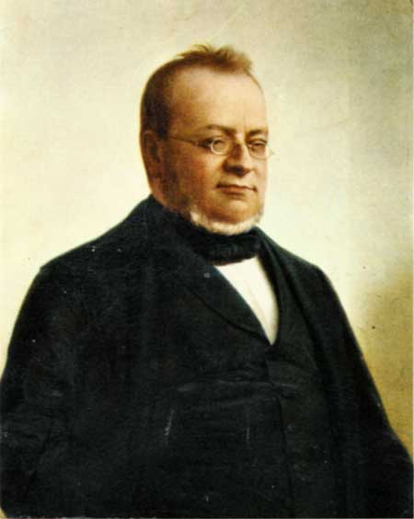
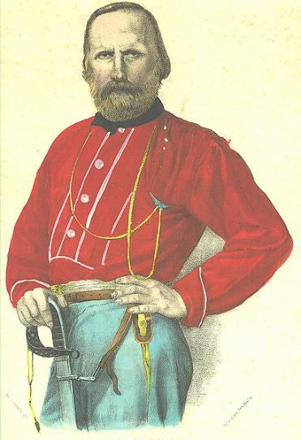
Camillo di Cavour
Giuseppe Garibaldi

Slide 11
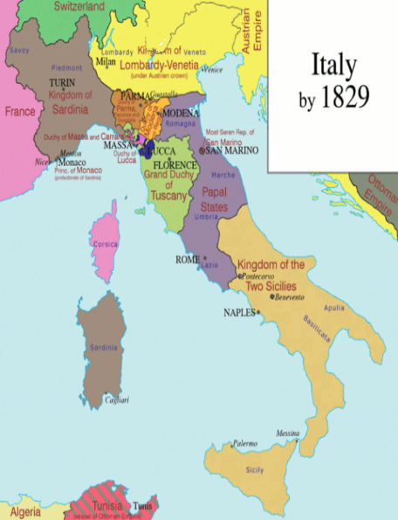
Nationalism Unification of Italy
Sardinia’s (NI) King appoints Camillo di Cavour as Prime Minister
Goal: gain control over northern Italy
Obstacle: most of northern Italy controlled by Austrian Empire
Tactic: get Napoleon III of France to help drive the Austrians out; it works

Slide 12
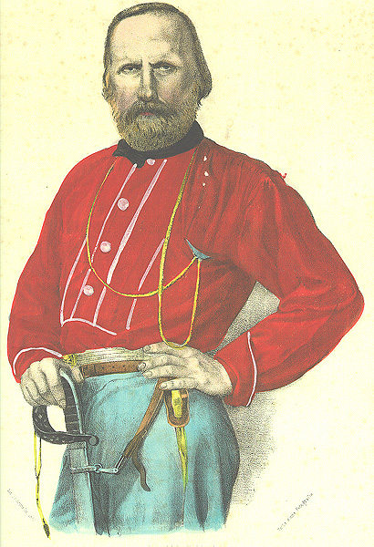
Nationalism Unification of Italy
Southern Italy
Giuseppe Garibaldi leads nationalist rebels (redshirts) and takes over Sicily (secretly aided by Sardinia)
Garibaldi and his troops march north, Cavour has his king meet Garibaldi in Naples, they unite the south to Sardinia
Garibaldi steps aside and lets the king rule over both parts in 1860

Slide 13
Nationalism Unification of Italy
The rest (Rome):
Venice leaves Austria (they let it go) and joins Italy in 1866
Garibaldi then threatens to conquer to Papal States; marches army in, Pope gives up and they give him Vatican City in return
The French have a presence in Rome until 1870 when the Franco-Prussian War forces them to withdraw completely leaving Rome to the Italians - Who make Rome their capital

Slide 14
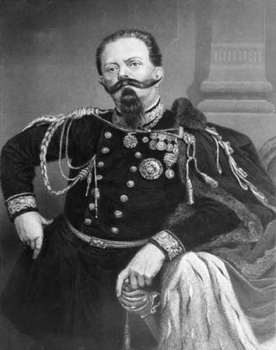
King Victor Emmanuel II

Slide 15
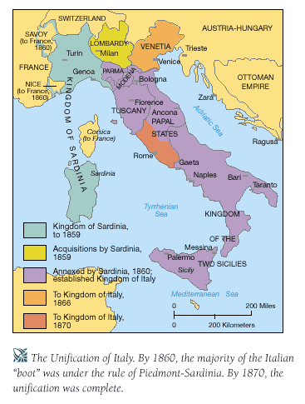
Italian unification

Slide 16
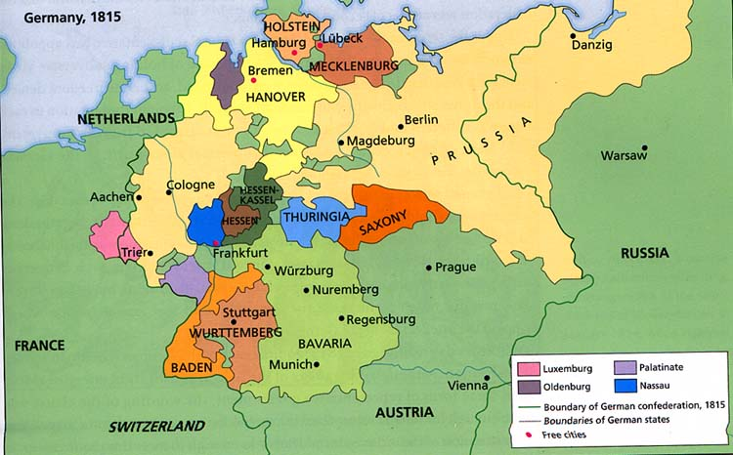
Germany: 1815
● Creation of the German Confederation under the presidency of Austria. Prussia and Austria were the two most powerful German states. Traditionally, Austria was recognized as the most important. There was a strong popular movement for unification but neither Austria nor Prussia was prepared to allow it happen.

Slide 17
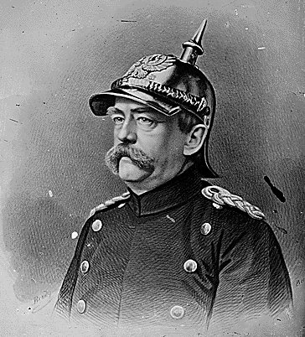
Otto Von Bismarck: “The Iron Chancellor” 1815-1898

Slide 18
Realpolitik
Bismarck
conservative, aristocrat, minister Wilhelm I in 1862
Chancellor of Northern Germany Confederation & then Germany from 1867-1890
Realpolitik: Realistic politics based on the needs of the state
Power more important than principles

Slide 19
Realpolitik
Goal – Prussian control of a united Germany
Steps to Unification
Confederation – Prussia strongest after 1848
Zollverein – open trade
Make the public scared – Prussia puts down liberal rebellions
Blood and Iron

Slide 20
Realpolitik
“Blood and Iron” Philosophy
He wanted to eliminate Austrian influence and bring about unification on Prussian terms.
Expand Germany’s economic and industrial base with use of its resources.
Put down liberals
Expand and unify though war
Increase the power and influence of the army
Not make the same mistake of 1848 – this won’t happen via conferences, speeches and majority voting

Slide 21
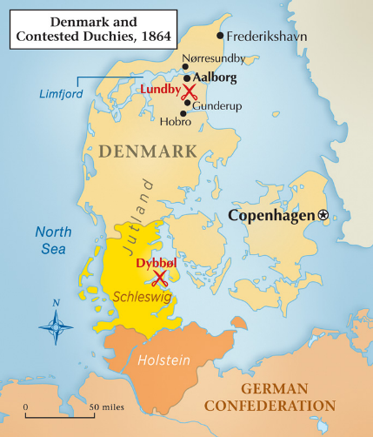
3 Wars for Unification
1st: An Austrian-Prussian invasion of Schleswig-Holstein
The Danish War (1864)
End of Danish control of these provinces.
Prussia gained a lot of support especially among German nationalists who wanted to see these provinces come under German control.
Sets up strange peace arrangement to promote discord, to lead to…

Slide 22
3 Wars for Unification
2nd: Austro-Prussian War (1866)
results in Prussian control of several northern German states.
Lasts 7 weeks
Spread “grievances to other German States
Dissolved the old confederation and establishes a new one dominated by Prussia
Southern states were left independent, form military alliances with Prussia

Slide 23
3 Wars for Unification
3rd: Franco-Prussian War (1870-1871)
Bismarck bates the French into war over small matter of succession
Has army at the ready on train tracks to attack
Riles up nationalism in West and South
Takes Alsace-Lorraine
Demolishes France in 6 months - really upsets balance of power and causes Britain to start to become “ok” with France to counter Germany
Wilhelm I of Prussia assumes the role of Kaiser, or emperor of Germany, with Otto von Bismarck as Chancellor.
Spends rest of his time as Chancellor messing with France
Treaty signed at….

Slide 24
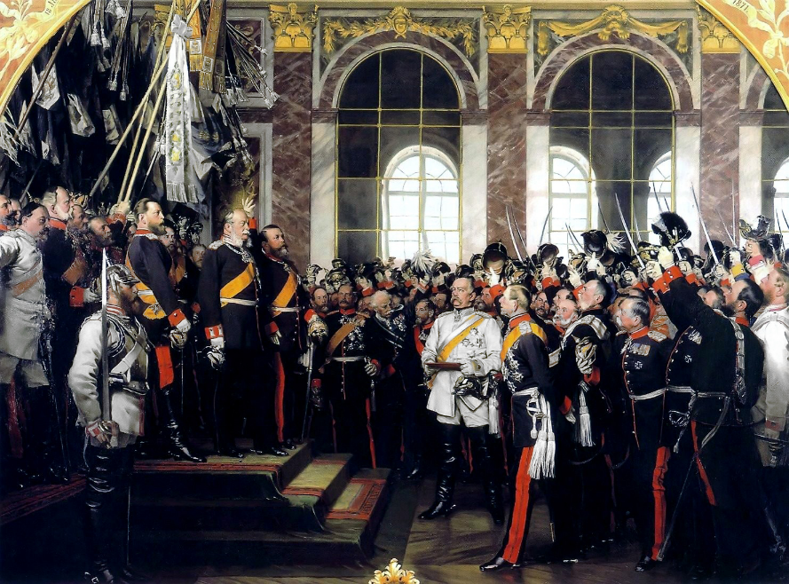

Slide 25
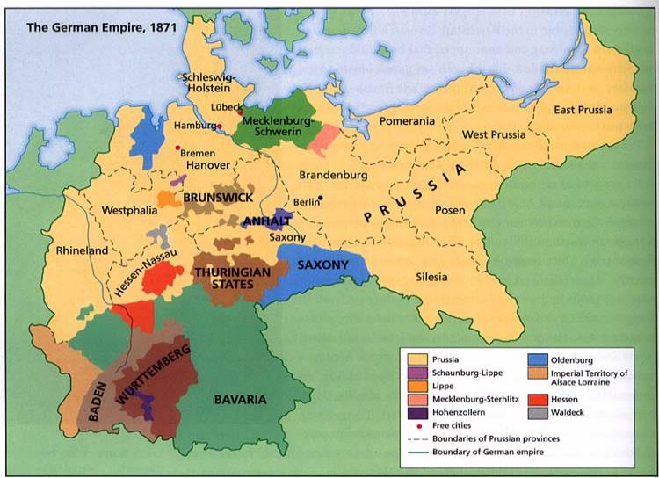
Germany: 1871
The new German Empire emerged as Europe’s foremost military power. Prussia dominated the new German state.

Slide 26
German Racial Nationalism
What does Teutonic mean?
Why would Germans be attracted to these types of theories at this time? (& historically other places too, not limited to Germany)
Why would I assign you to read these excerpts?

Slide 27
Other nationalist movements
Ireland tries to break with UK after the famine (and then tries again, and again, and again)—leads to Rebellion, Civil War, IRA, etc.
Balkans (most notably Serbia) try to break with Ottoman Empire and/or Austria Hungary—forming something called Greater Serbia (lots more on this later) which is still and issue today
France tries to rally against “foreign” issues and united in Anti-Semitism, Dreyfus Affair
Russia has to deal with autocrats ruling a huge, decaying empire

Slide 28
Types of Nationalist Movements
Unification
Mergers of politically divided but culturally similar lands
19th century Germany
19th century Italy
Separation
Culturally distant group resists being added to a state or tries to break away
Balkans in the Ottoman Empire
French-Canadians in Canada
Ireland
State-building
Culturally distinct groups form into a new state by accepting a single culture
The United States
Turkey
USSR

Slide 29
New face of Europe
Britain and Germany now the most powerful nations in Europe
France defeated, but still fairly strong
Austria and Russia lagged far behind, and were falling apart
Ottoman Empire was there but DOA
Lots of unrest still in the Balkans (more on this later)
Seeds are sown for the biggest conflict “the world had ever seen”
Next: Britain, France, colonialism in Africa – all leading up to World War I

