Slide 1
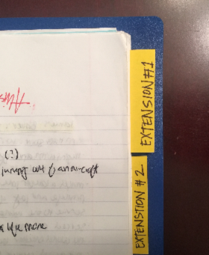
Turn in your Journal to the white bin AFTER completing the following:
Under “Journal Entries – Daily Work”, in the margin to the left of “Student brings a variety of outside sources into journal…”
Write: “# of Extensions: (insert # here)”
Put in number of Extension pieces I should be looking for when I grade your journal
Mark your extension pieces with a post-it
Please flag your extensions so that it looks like the journal to the right
Get the small post-its from me

