Slide 1
Thesis
After the destruction of World War I, the conquering Allies tried to create a new world order that would usher in lasting peace and prosperity. However, they did this without understanding the sociocultural implications of the defeated nations. The end results, coupled with a series of economic problems led to massive political disasters with the rise of a new, seemingly promising form of government, fascism.

Slide 2
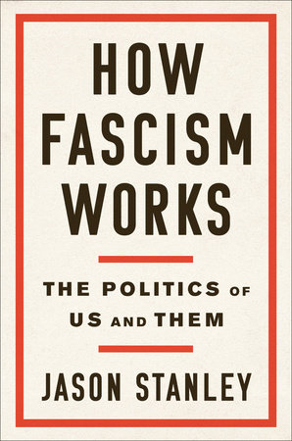
Yale Professor Jason Stanley:
“Fascism is a method of politics. It’s a rhetoric, a way of running for power. Of course, that’s connected to fascist ideology, because fascist ideology centers on power. But I really see fascism as a technique to gain power.”

Slide 3
Worldwide Depression
Interwar & Rise of Fascism Introduction

Slide 4
Economic problems
Great War (WW I) left Europe devastated and bankrupt
Many new countries unstable
Russia in a civil war
Poland, Hungary, Austria all struggle with attempted coups→ Coups succeed in Latvia & Estonia
Many coalition governments→ no one party wins majority, so must create temporary alliances for majority
Italy economics shaken→ Mussolini comes to power
Germany on the edge of revolution

Slide 5
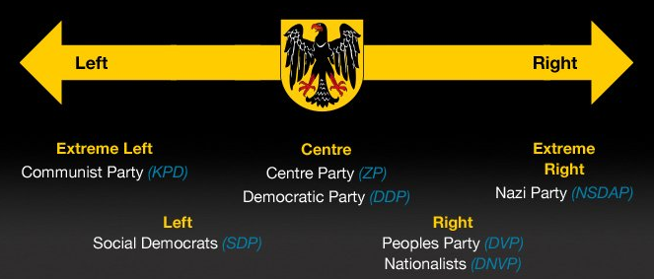
Weimar Republic
Germany 1919 - Democratic government after a year of revolution
Weimar – city in central Germany
DOA - No democratic tradition in Germany
Country was broke
People blamed the new government for humiliation at Versailles, not the old leaders

Slide 6
Inflation
Germany had $33 billion dollars – for first part of reparations to pay
Simply printed money to do it (not taxes like other countries in the war)
Paper money needs to have gold or credit behind it – Germany had none
Inflation takes off as the money becomes worth less and less
1918 – loaf of bread cost one Mark
1922 – 160 Marks
1923 – 200,000,000,000 Marks
4.2 trillion marks to 1 US Dollar

Slide 7
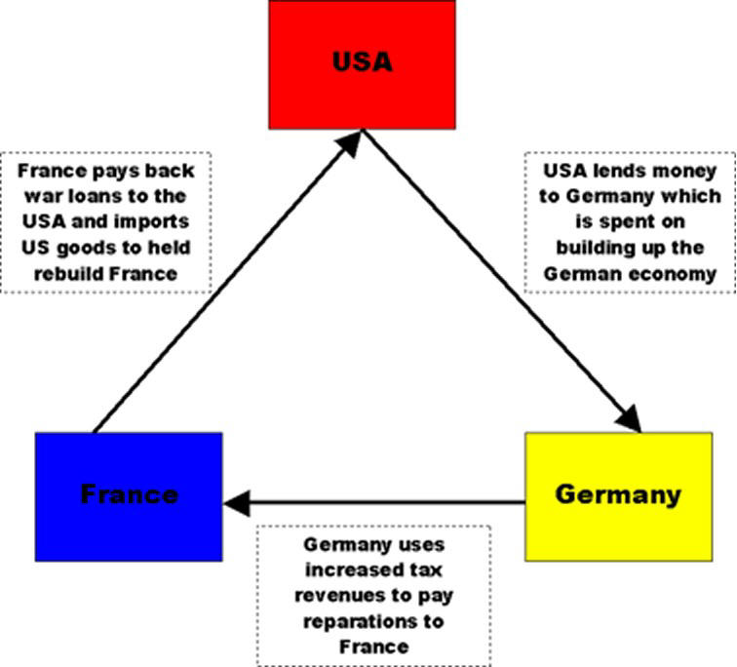
Inflation
People brought wheelbarrows full of paper money to buy groceries
Used Marks for wallpaper (insulation) and in fires to keep warm
America to the rescue – Dawes Plan
Bankers stabilize the currency with a loan
Germany slow starts to recover
By 1929, Germany was manufacturing as much as before World War I

Slide 8
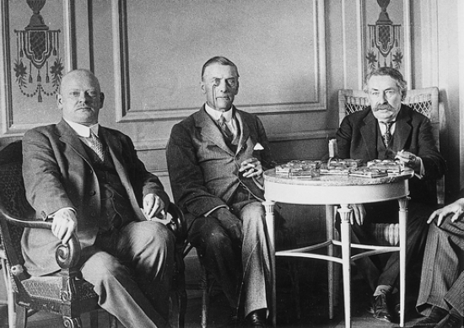
Making nice w/Europe
Germany and France (& Belgium, Italy and Britain) attempt to mend fences
1925 – Treaty of Locarno signed
Foreign Ministers from F & G
Germany & France-war no more (um…)
1928 – Kellogg-Briand Pact
Most nations (including US and USSR) sign
Pledge to renounce warfare

Slide 9
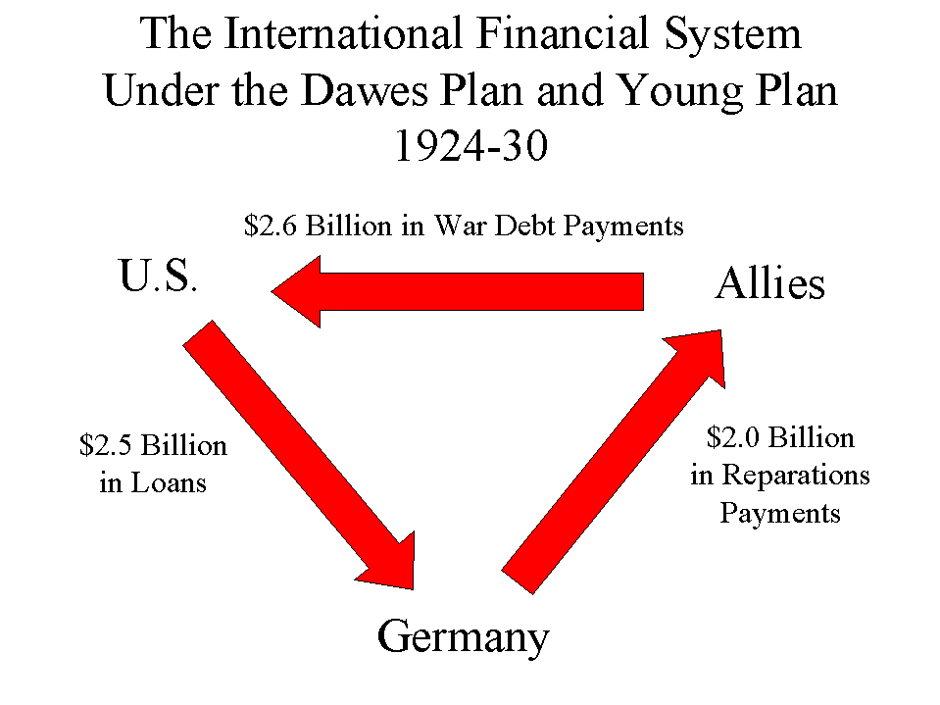
Depression
1929 – US stock market
crashes
Great Depression
Europe owes US a lot of
money (WWI & Dawes)
American banks call in loans from Europe
They can’t pay
Depression spreads
Guess which country is the first to collapse in Europe
Germany!

Slide 10
European & US response
Britain
Coalition government unifies country
Taxes raised, interest rates lowered
Democracy saved
France
Popular Front (socialists, communists, liberals, conservatives) all unite
Unemployment stays high, but democracy preserved

Slide 11
European & US response
Scandinavia
All three had socialist governments
Increased taxes, spending on public work programs
Increased welfare benefits
Preserved democracy and started economic growth
United States
Roosevelt’s “New Deal” very similar to Scandinavia
Germany & Italy
Unfortunately, another story altogether….

Slide 12
Fascism
Very little in terms of an ideological platform
Emphasized loyalty to the state & obedience to its leader
No defined economic theory or program,
but all had some aspect of the economy controlled by the state
Extreme form of nationalism – racial superiority
Believed nations MUST struggle
Peacefulness was a sign of weakness
Peaceful states are doomed to be conquered
Social control - Uniforms, salutes, mass rallies

Slide 13
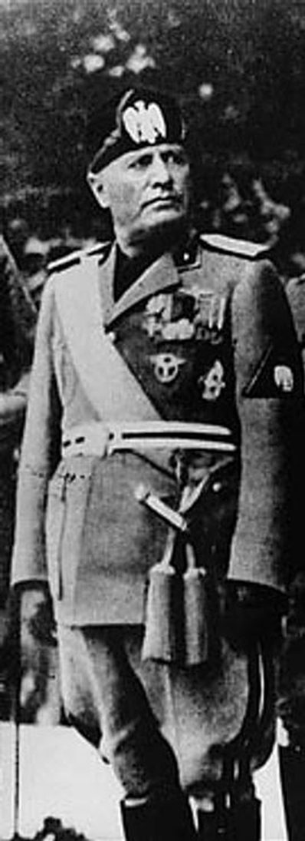
Italy
Italy after 1919
Bitter. Why?
Economics
Government
Who will save us?
Benito Mussolini

Slide 14
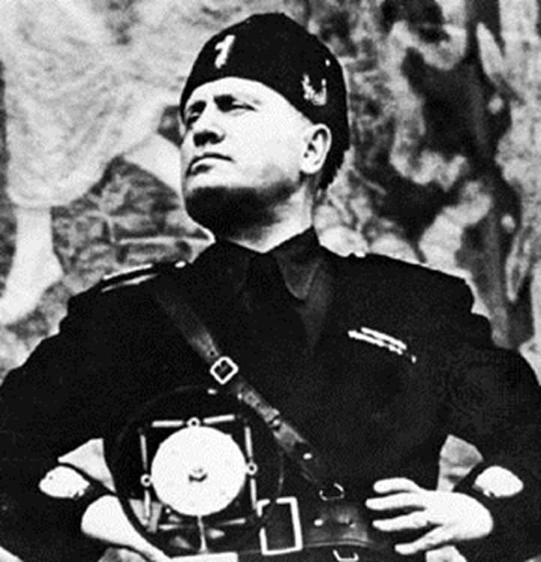
Mussolini
Former newspaper editor
Founded the Fascist Party in 1919
Outspoken
Black Shirts
Worker rebellion?
October 1922 – March on Rome
30,000 Fascists
Demands on the King

Slide 15
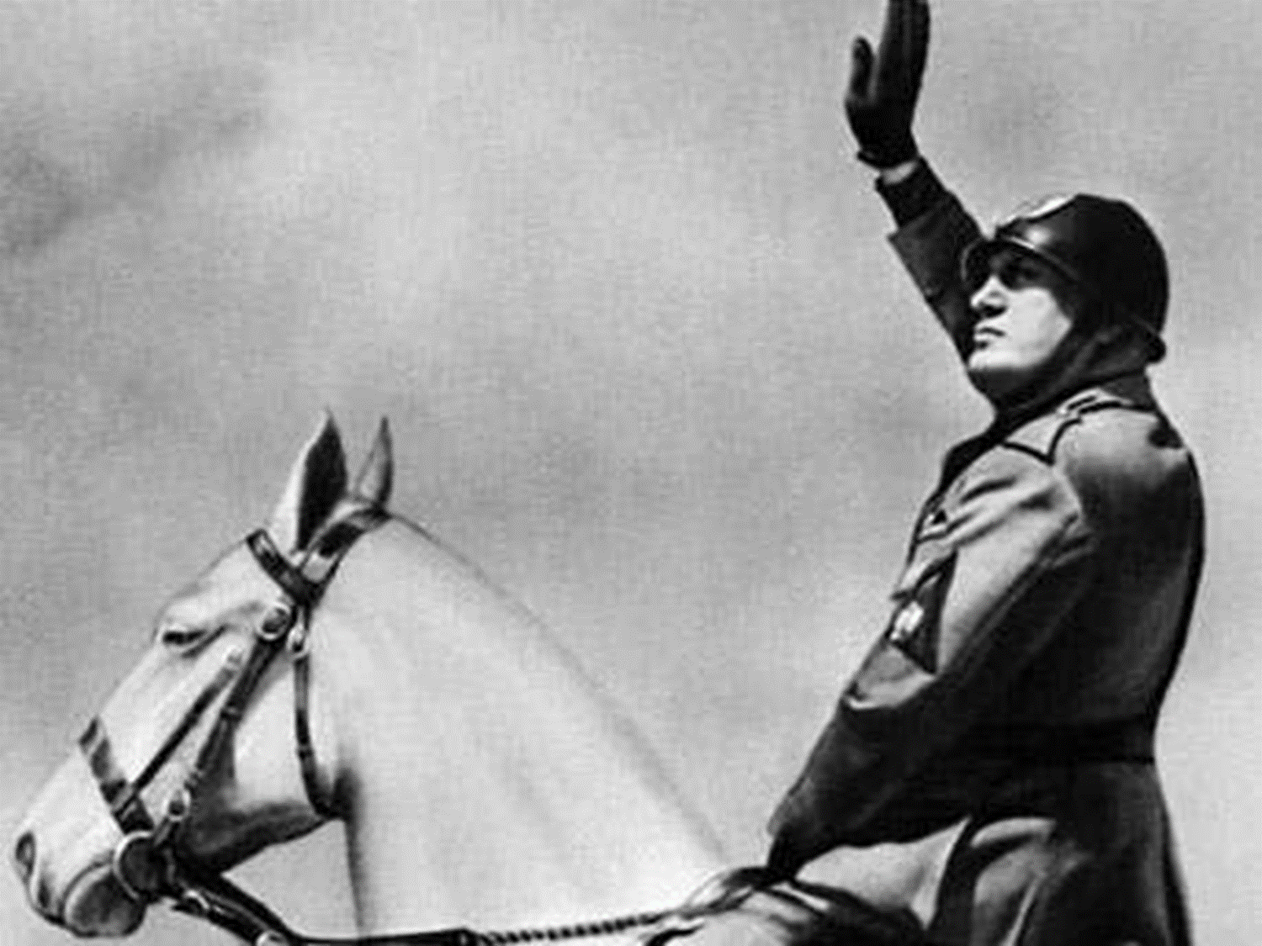
Mussolini
King appoints Mussolini as head of government
il Duce – the leader
Abolished democracy
Outlawed all political parties
Censorship
Strikes outlawed
Industrialists courted
Never as effective as Hitler or Stalin

Slide 16
Mussolini
According to Mussolini…
Why should the state have total power?
How is the Fascist state democratic?
How do Fascists feel about – war, socialism, liberalism?
How does Fascism enhance individuals lives?

Slide 17
Fascism
Very little in terms of an ideological platform
Emphasized loyalty to the state & obedience to its leader
No defined economic theory or program,
but all had some aspect of the economy controlled by the state
Extreme form of nationalism – racial superiority
Believed nations MUST struggle
Peacefulness was a sign of weakness
Peaceful states are doomed to be conquered
Social control - Uniforms, salutes, mass rallies

Slide 18
Fascism v. Communism
Similarities
In practice in the 30’s & 40’s both are totalitarian
Both allowed only one political party to exist
Both denied individual rights
Neither had any democracy at all
Any others?

Slide 19
Fascism v. Communism
Differences
Fascists did not want a classless society
All people are NOT equal to them
Fascist groups made up of many types of people
Aristocrats, industrialists, war veterans, working class
One other difference – fascists were nationalists while communists were INTERnationalists aimed at uniting workers worldwide

