Slide 1
Keylor 211-218 ISI Article
Describe the course of foreign policy FDR chose to pursue in Latin America in the 1930s.
What is Pan-Americanism & how was it fostered by both the United States and Latin America?
Quickly summarize the general outcome of the various conferences the American countries conducted during the 30s & early 40s.
How did the Americas try to organize a defense against the Axis threat? How did they support the US during WWII?
Define and explain ISI.
How and why did Latin American have a different experience from most of the rest of the world during the Great Depression?
Who is Getulio Vargas and how did he impact Brazil during the Depression?
Explain Estado Novo. How did it impact Brazil? What “ism” did it appeal to?

Slide 2
Now…
Write a quick thesis about the changes in Latin America in the 1930s based on the evidence just discussed on the notecard provided.
Back it up with brief but specific, bulleted evidence on the back side of the card
Names on the back with the evidence

Slide 3
Thesis
While the rest of the world was experiencing the Great Depression, much of Latin America used the lack of economic imperialism to replace their economic systems with ISI, softening the blow of Depression significantly. This allowed Latin Americans to begin to throw off the yoke of the United States—which was forced to move from “Big Stick” to “Good Neighbor Policy” to retain some influence in the region. Without the domineering US, many Latin American countries began to further their own economic systems and governments, to mixed results.

Slide 4
Getulio Vargas & Brazil
Brazil experiences a “revolution” in 1930
Mostly non violent, but Old Republic President Washington Luis leaves power
Most of this had to with the Brazilian government subsidizing the coffee industry to keep it vibrant and prices good → falls apart when world experiences Depression
Succeeded by Getulio Vargas—a landed Populist—who seizes power after disputed election
1st Vargas Presidency can be divided into three phases:
Provisional Government (1930-1934)
Constitution & Presidency (1934-1937)
Estado Novo (1937-1945)
Vargas is only actually legally elected during the second phase of 1st presidency
Will be legally elected President of Brazil in 1951, where he will remain until he commits suicide, while in office in 1954

Slide 5
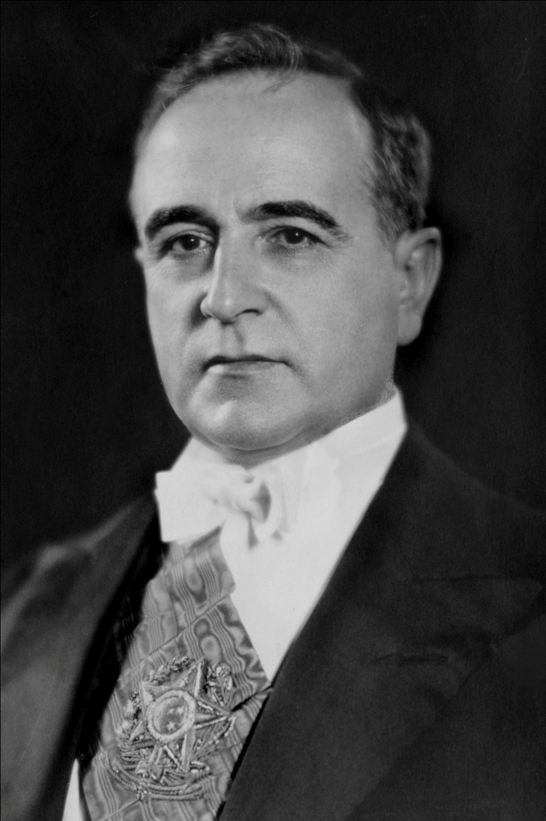

Slide 6
Estado Novo
Means “the new state”—taken from the name of the Portuguese dictatorship that sprung up in the wake of fascism & Franco
By ’34 Vargas is starting to lose control of his coalitions and begins to copy some fascist tactics—curtailing press freedoms, violent crackdowns—to keep power
By posturing himself as the opposite of communism he wins the 1934 election, barely
Term will expire in 1938, barred from running again by new constitution
He then centralizes his authority in Rio, instituting a command economy that does succeed in getting investment and manufacturing going

Slide 7
Estado Novo
Nov. 10, 1937 comes on radio and announces there is a “communist” plot to overthrow him and seizes power in a coup (of sorts)
Disbands other political parties, stops critically presses—but stays Populist
Creates a number of central organizations to look after the people (almost like the beginning of a welfare state)
Makes good with the US where he becomes very popular; enters WWII on side of Allies
Remains very popular with people of Brazil
Finally forced out by own minsters after the war (dictatorships are not popular anymore) who return Brazil to democracy

Slide 8
The Rest of Latin America
US continues Good Neighbor Policy in most dealings with Latin America
Many countries use increased wealth to kick out foreign corporations and nationalize their key industries like oil
This upsets Europeans and US some, but there a bit preoccupied with Hitler
Install puppet governments in some states, but only the smaller ones
But… industrialization slows significantly with the end of World War II,
which leads to Revolution…

Slide 9
Our America
With a turn & talk partner, answer:
1. What is Jose Marti’s argument?
2. Why does Marti believe what he believes (what are his supporting arguments?)
3. What does Marti think the general feeling that natives have in Latin America?
4. What does Marti think that the colonial powers should do?
5. Why would we read this now, not earlier in the course?

