Slide 1
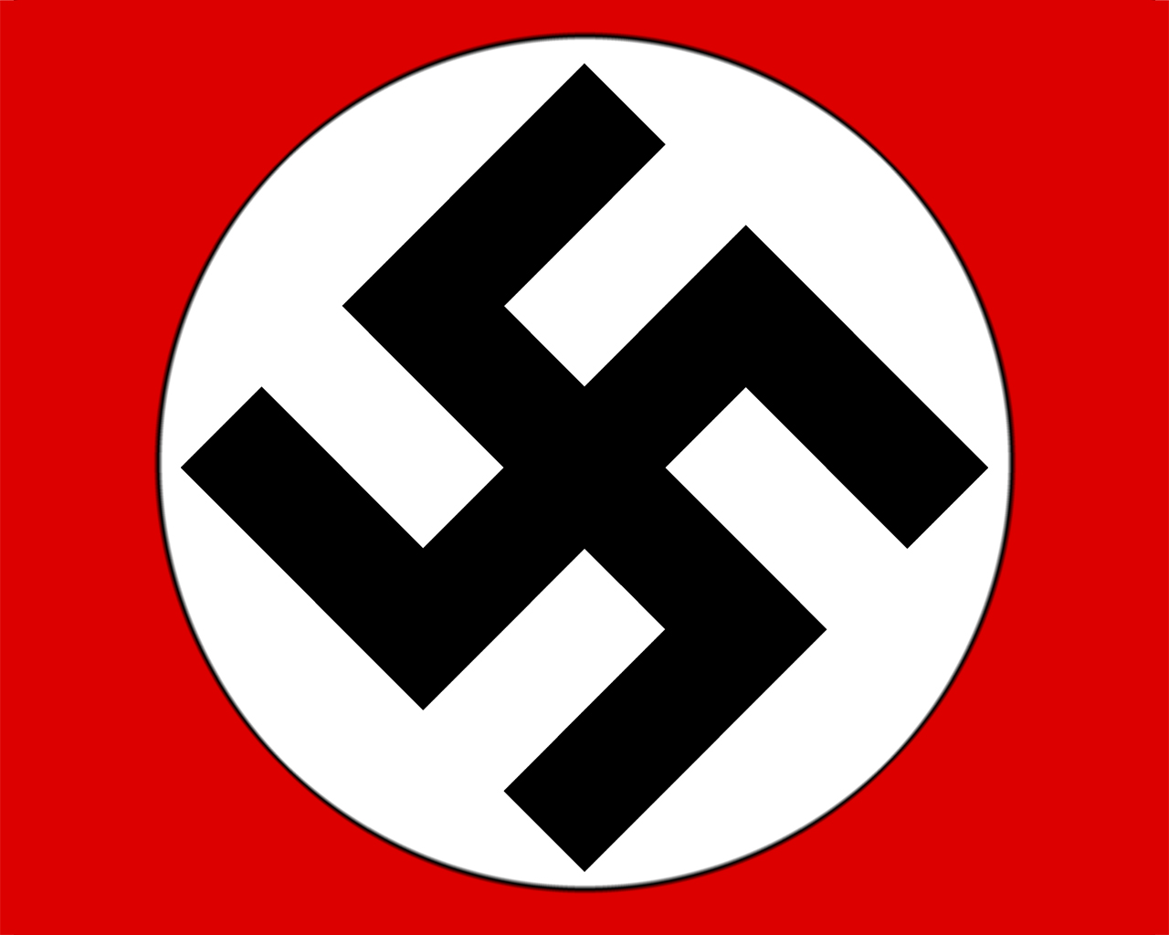
The Nazi rise to power and its consequences
1923-1938

Slide 2
Thesis
Learning from the tactics of Benito Mussolini, the failed Beer Hall Putsch, and the propaganda genius of Joseph Goebbels, the Nazi Party, upset with the terms imposed on Germany, created an appealing electoral platform that spoke to the needs of the common people of Germany. However, once it came to power it began to impose its real racial theories on the German people, who, smitten with their newfound, comfortable lives, the rebirth of Prussian ideas, and the new world status of German superiority, happily acquiesced to the new “truths” of their perceived flawless leaders.

Slide 3
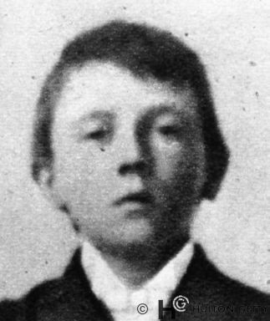
Adolf Hitler
Born in Austria
Abused as a child → felt guilty about something, but historians cannot agree on what
Tried to get into art school, failed, blamed the Jews
Time in Vienna develops Weltanschauung (see next slide)
Fought and was highly decorated in WWI—runner, war romantic
Came back to Germany and got into politics around 1921 → infiltrated the Nazi party at the suggestion of Ludendorff
Propaganda minister, then party leader

Slide 4
Adolf Hitler
Schonerer – pan German State, anti-Semitic
Karl Luger – Mayor of Vienna, demagogic, mass propaganda, anti-Semitic
Liebenfels – Volk, swastika, other races were “animal men”, anti-Semitic
Thule Society - racial purity, militant, attack Jews, anti-Semitic
Dietrich Eckhart – national savior, mentors Hitler, introduce to wealthy

Slide 5
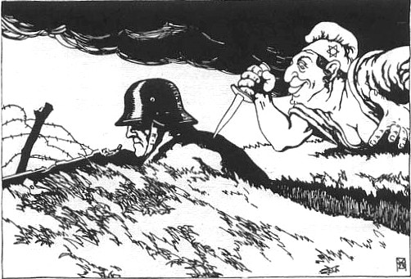
Issues right after WWI
German Revolution of 1918-1919
Adds to Stab-in-the-back myth perpetuated by Ludendorff
Germany still being blockaded by Britain
Formation of Weimar Republic
And attempt to pay reparations, poorly
Become known as the November criminals
League of Nations also fails
Treaty of Locarno
Kellogg-Briand Pact

Slide 6
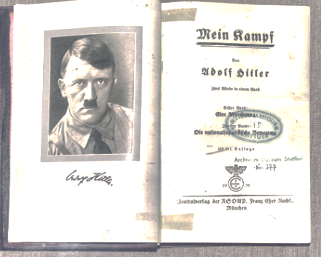
Beer Hall Putsch
November 8-9, 1923 Hitler tried to start a coup in Munich (Bavaria was in crisis)
Rouses the people, via gunfire and speeches—many later top Nazis involved
First major use of the SA (brownshirts)
Suppressed that night
Hitler & others tried for high treason
sentenced to a whopping 5 years in jail
Serves 9 months
National Stage
In prison writes Mein Kampf

Slide 7
Nazi Party’s electoral appeal
Begin running seriously in 1925 (achieve plurality by 1933; eventually outlaw other parties)
Realize not going to take over by force
Work within the system to gain power
Platform: Germany’s foreign, domestic and economic policy are in disorder and need to the remedied. To do this:
Foreign policy:
Restore 1914 borders
Trade union in North Baltic
Colonial Empire in Africa
Pan-European League

Slide 8
Nazi Party’s electoral appeal
Domestic Policy:
Modified form of democracy
Integration of religion into schools
Restoration of “older” forms of arts – no modernism
Unification of the press around the state
Universal healthcare
Universal higher education
Expulsion of Jews who immigrated after 1914 (dangerous 5th column); stop immigration
Economic Policy:
Nationalization of key industries
Building infrastructure (autobahn)
Compulsory unionization
Farm subsidies and redistribution of large farms
Creation on governing industrial bureaus

Slide 9
Chancellor Hitler
Germany back to pre-WWI industrial levels by 1929
Great Depression hits Oct. 29, 1929
Country begins to fall apart
1932-Hindenburg runs for 3rd term and wins, but Nazis get most votes in Reichstag w/ 37% after major propaganda campaign by Goebbles
Form coalition to appoint Hitler Chancellor
Done in small ceremony but then marches SA through Brandenburg gate

Slide 10
Hitler Takes Power
Divide up the different readings among your group
What is the significance of your reading?
How did it impact the rise of the Nazi party?
Why do you think the people of Germany went along with these things?
Let’s share this information with your groupmates

Slide 11
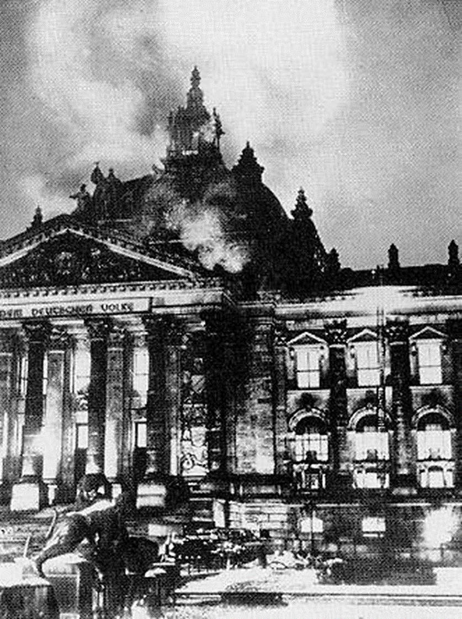
Reichstag Fire & End of Weimar
Jan 31, 1933, Proclamation of the Reich Gov’t to the German People
Volk revolution, national revolution
Feb 4th Outlaw public meetings and curtail freedom of press
Feb 27th 1933, Reichstag burns down → Nazis claim to find communists inside and blame it on them
Day after-Decree for the Protection of the People & State
creation of police state → legal reign of terror

Slide 12
Reichstag Fire & End of Weimar
March 1933, Suspend habeus corpus & recall elections and win 43% of vote (not a majority like they wished), so pressure other legislature into voting with them (Gleichschaltung)
SA disorder – replace local govt with Nazi (Wurttemberg example)
May 1933, Day of National Labor
Speeches, spoke of Volksgemeinschaft
Next day SA & SS take over trade union offices and arrest leaders
Enabling Act
4 years – most thought Hindenburg would control
Hindenburg dies in 1934, instead of calling elections Nazis pressure Reichstag into appointing Hitler führer (Fuhrerprinzip)

Slide 13
Nazi Terminology
Gleichschaltung
Technically, coordination
Really meant “nazification” of the state’s social and political institutions
Volksgemeinschaft
Nazi national people’s community
Fuhrerprinzip
The leader principle, one party united under one leader
Lebensraum
Living spaces, right of superior nations to gain through foreign expansion (Eastern Europe & Western USSR)

Slide 14
Acts as Chancellor & Führer
Creates & emphasizes Volksgemeinschaft
Opens Dachau concentration camp opens in 1933
Book burning
Yearly party rallies
Gleichschaltung of the arts and the press
Propaganda via Joseph Goebbles → radios and Mein Kampf
Nuremberg laws against the Jews
Remilitarization of the Rhineland
Fascist architecture
June 30, 1934: Reorganizes close associates in Night of the Long Knives → Rohm and SA out, Himmler and SS in

Slide 15
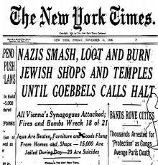
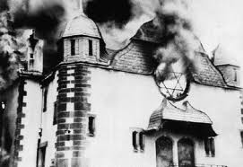
Kristallnacht
Nazis originally ask the Jews to leave → some do, but most other countries do not want them either
Pass Nuremberg laws in 1935 which deprive Jews of civil rights and citizenship
November 9-10, 1938 Nazi thugs raid Jewish temples, place of work, etc. and steal, break, and burn everything.
Goebbels then “mercifully” orders the Germans to stop
Marks the start of the Holocaust

Slide 16
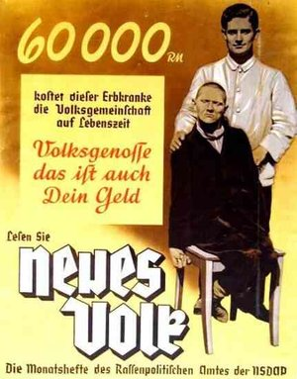
Aktion T4
Second example of use of eugenics by Nazis
Forced sterilization or “mercy death” of undesirables with some type of hereditary defect
Used as experimentation for Jewish extermination

Slide 17
Other Holocaust Documents
What stood out to you?
What questions do you have?
Shows how things are done in stages… did not jump right to death camps
We will continue to talk about it all during the next unit – so you need to remember them (especially as you are reading Night)

Slide 18
Nazi Propaganda
c. 1930-1944

Slide 19
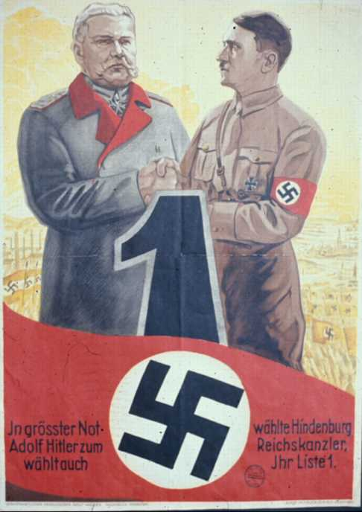
1933
"In the deepest need Hindenburg chose Adolf Hitler for Reich Chancellor. You too should vote for List 1."

Slide 20
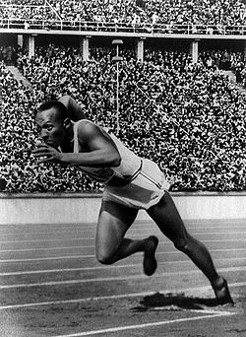
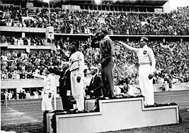
1936 Berlin Olympics
Tell me what you learned?
Coincidentally Berlin had been awarded 1936 before Hitler came to power
Hitler and Speer tried to built architecturally dominant stadium and show off Nazi power and racial might
Jesse Owens represents USA and crushes all Nazi competition, most famously Luz Long, showing up Hitler

Slide 21
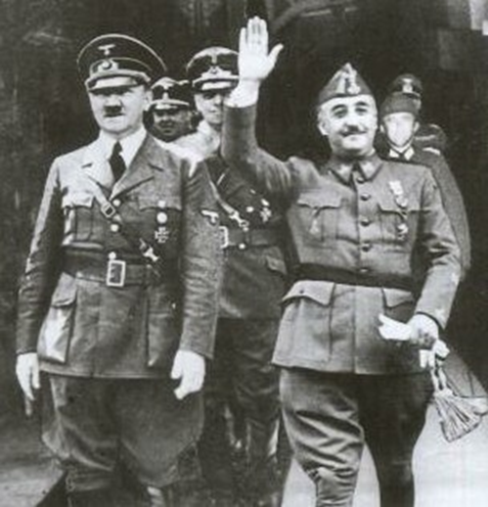
Spanish Civil War
Spain was a monarchy until 1931
Then became a republic
Military leaders stage a coup in 1936
General Francisco Franco leads them
Civil war breaks out
Franco has no $$ but support of people
Other countries/interest groups provide $$ and war heats up
Rebels get full army and take capital in three years
Most important because it becomes testing group for new weapons developed since WWI

Slide 22
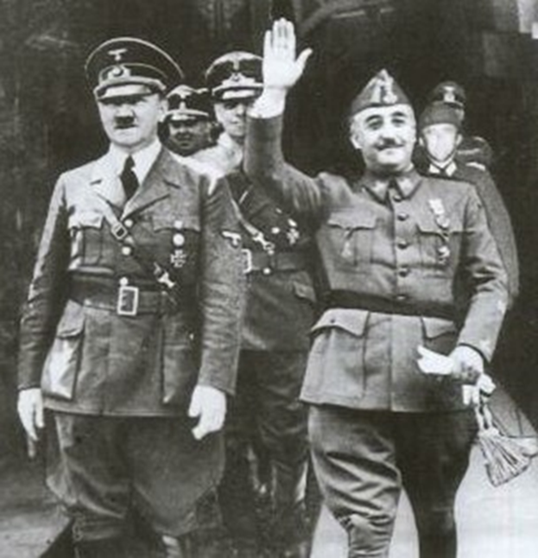
Spanish Civil War
Most important because it becomes testing group for new weapons developed since WWI
Hitler and Mussolini send troops, money and planes to help Franco
Stalin and Mexico send money and troops to the Republic’s side
Franco wins in 1939, becomes Spain’s fascist dictator
Assumes total power, executes over 100,000+ rivals (arguably genocide)
Friendly with Hitler & Mussolini
Doesn’t join the Axis
Takes power in the summer of 1939; Dies in 1973 and returns crown Spanish royal family

Slide 23
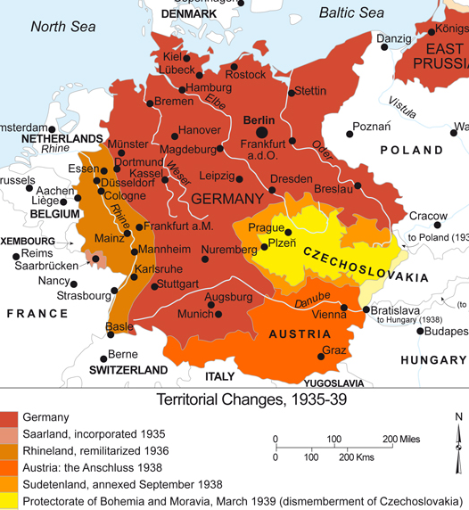
Lebensraum
What did you learn about in Keylor?
Hitler claims that racially superior Germans need more room in Europe to “spread out”
Begins by annexing Austria in the Anschluss; Austria welcomes him to cheers
Takes over part of Czechoslovakia (Sudetenland) and world finally starts to care

Slide 24
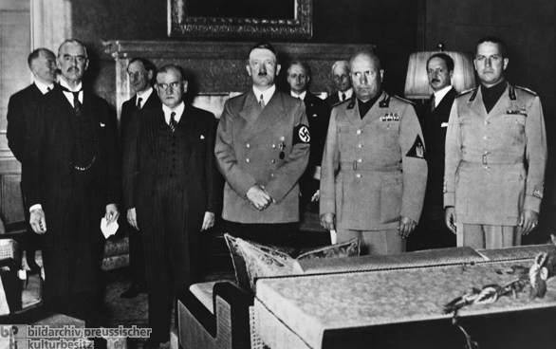
Munich Conference
Meets with Britain and France at Munich conference in 1938
Brit & France: More concerned with economies than politics
Give Hitler what he wants as long as he promises to take no more
Follow policy of appeasement
“Peace in our times”
Annexes the rest of Czechoslovakia a few months later

Slide 25
State Destruction
In order to prep—make local citizens not be outraged/act against it— Eastern Europe for the Holocaust… Hitler, et al. must destroy the institutions and states of their new territory
This creates a system of lawlessness which allow paramilitary and extrajudicial acts of terror on the civilian population to occur
Hitler uses a seven step process to get this done:
Creation of the party-state – making the state part of and subservient to the party; all parts of the state & party are intertwined; everyone must be a Nazi
Entrepreneurship of violence – In order to keep the party in power (perpetual conflict), paramilitary organizations loyal to the party/Hitler (not the state) that produce violence (not sanctioned but tacitly allowed) like the SS and SA
Exportation of anarchy – encouraging lawlessness outside of Germany to “protect” the people inside

Slide 26
State Destruction
Hitler uses a seven step process to get this done:
Hybridization of institutions – Racial organizations were merged with instruments of the state → crime against the state = crime against the race; extra-state organizations merge with those of state (SS + police = SD)
Precedent of statelessness – allowing entities outside of the state to inflict “laws” (i.e. SS @ Dachau) effectively creating pockets of lawlessness
Globalization of (at first German) Jews – making Jews seem a larger entity than they were (>1% of German population) and removing them from the state (Nuremberg Laws) creating second class citizens, making killing easier
The redefinition of war – the goal of war becomes not just to take territory but to take control of entire states and master entire races
This all culminates in Generalplan Ost

Slide 27
Generalplan Ost
Going back to the theory of lebensraum,
Nazis planned to use the East to “spread out”
conquest and subjugation of Baltics was a necessity
Germans had history (Teutonic Knights) ruling Baltics, esp. Lithuania → German was language of nobility
Alfred Rosenberg—Estonian racial theorist—put plan into place for what to do with the German East. This is the core of Nazism:
Involved division into four districts
Removal of excess mass labor to the East temporarily, and resettlement of slaves after the war
Elimination of the Jewish question (original idea was resettlement in Madagascar)
Elimination of Bolshevism & Pan Slavism
Establishment of master race; settlement of farmland
Hans Frank began implementation in Poland; next step was USSR

Slide 28
Einsatzgruppen
Branch of the SS that goes behind the army and kills “undesirables”
Responsible for 100s-1000s of mass graves

Slide 29
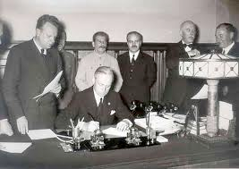
Molotov-Ribbentrop Pact
Nazi foreign minister Ribbentrop goes to Moscow and makes a deal of non aggression (Aug. 1939)
Two also agree in secret to divide up Poland and other parts of the Bloodlands
Signifies:
USSR will not be on same side as WWI
Hitler will not have to fight a two front war
(aka) Nazi-Soviet non aggression pact or Hitler-Stalin pact

Slide 30
Invasion of Poland
Germany upset with East Prussia and Polish corridor
Hitler demands Poland give up Danzig
Danzig was a German port city given to Poland in 1919 after WWI
Hitler orders Heydrich and Himmler to implement Operation Himmler
Two stage attacks on Germany via Poland—use Dachau prisoners as “attackers”
“I will provide a propagandistic casus belli. Its credibility doesn't matter. The victor will not be asked whether he told the truth” --Hitler
Poland refuses, asks Britain and France for help
Britain and France ask USSR to join in alliance against Hitler; Stalin refuses
Germany invades Poland September 1, 1939 to start WWII
Using Blitzkrieg, crushes the country within days, Poland formally surrenders within a month
USSR invades Sept. 17 fulfilling terms of the Molotov-Ribbentrop pact and allowing Stalin to get revenge for Polish-Soviet War
Executes 4,000 Polish officers who surrendered in the Katyn Massacre

