Slide 1
TOK Rough Draft Essay Feedback
Some things to guide to the comments given on turnitin.com and next steps

Slide 2
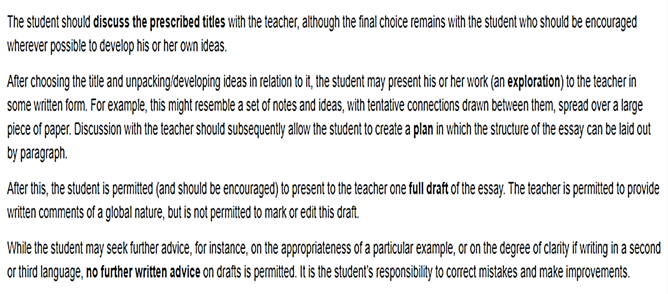

Slide 3
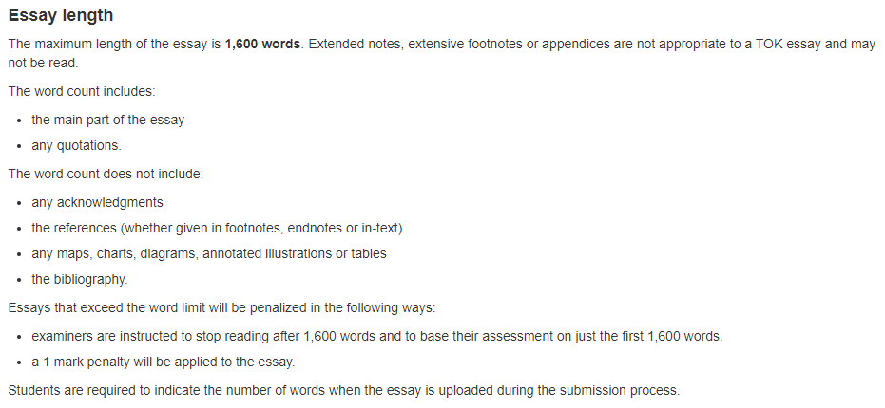

Slide 4
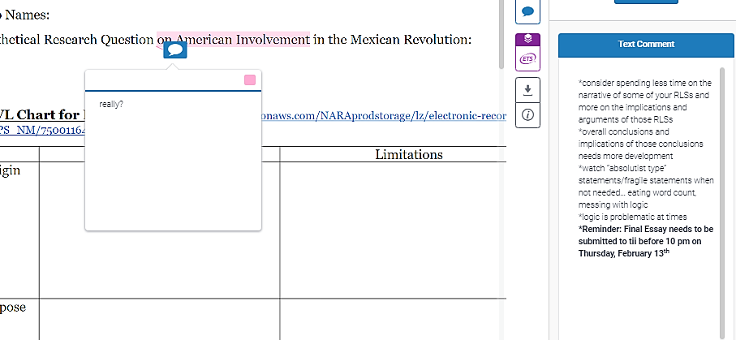
Take note: this means there are larger issues of it in your essay, the talking box comment is just one example! It is your responsibility to go through the rest of the essay and fix the rest! This is for all ‘Text Comments’ not just the logic example I have here

Slide 5
Possible overall Text comments
needs more consideration of the implications/assumptions written into the title
watch “absolutist type” statements/fragile statements-logic is problematic at times
need to spend more time exploring implications of arguments
counterclaims should be explored with more depth
some awareness of knowledge questions related to the title, but needs more exploration
try to avoid hypothetical, generalized examples
AOKs &/or WOKs need to be treated with greater depth and precision
pay attention to TOK terminology, use it correctly

Slide 6
Text comments
needs more consideration of the implications/assumptions written into the title
This means more than just defining terms
While good to do, shouldn’t just end there
And be careful about just listing definitions at the beginning – that may make a examiner groan & then you will be working your way back up for the rest of the essay
What are the assumptions and implications in the title

Slide 7
Text comments
needs more consideration of the implications/assumptions written into the title
watch “absolutist type” statements/fragile statements
logic is problematic at times

Slide 8
“absolutist”-fragile statements
Absolutist statements – can’t think in oversimplified terms – like don’t say every TOK discussion just ends with someone saying we will never really know and its done – the world doesn’t work that way… it’s a logical fallacy – which one is it?
And speaking of logical fallacies – you need to revisit, they were put in your textbook for a reason, you are falling into them! (hint: Journal #13)

Slide 9
comments
needs more consideration of the implications/assumptions written into the title
watch “absolutist type” statements/fragile statements
logic is problematic at times
need to spend more time exploring implications of arguments
counterclaims should be explored with more depth
some awareness of knowledge questions related to the title, but needs more exploration

Slide 10
Knowledge Questions
2 main problems
Wording – the ideas are there, but gets lost in the phrasing
Too far afield from the PT…
might be topically related, but doesn’t really help you to unpack the PT
OR – maybe it is related, but you are not connecting
And can we talk about things that “beg” a question – there are some logic issues here

Slide 12
Knowledge Questions
Knowledge Questions
look back at handout, remind yourself
Feedback from 15+ year examiner:
Not so specific, more general
Abstract
Universal application–multiple fields
Portable and bridging to multiple areas
Has to have at least one–but not too many–knowledge concepts
Sometimes more succinct
Provokes to challenge the question itself
Open-ended
Un-google-able – needs to engage with the ambiguity
Shouldn’t be a leading question – don’t decide your answer and then work backward

Slide 13
comments
needs more consideration of the implications/assumptions written into the title
watch “absolutist type” statements/fragile statements
logic is problematic at times
need to spend more time exploring implications of arguments
counterclaims should be explored with more depth
some awareness of knowledge questions related to the title, but needs more exploration
try to avoid hypothetical, generalized examples
AOKs &/or WOKs need to be treated with greater depth and precision

Slide 14
AOK-WOK
WOK, it isn’t how many you can use, it is about exploring with depth and precision…
Need to show how they operate differently in each AOK
Reason – talk about it and how its role changes across the two AOKs – don’t have them exist separately
Don’t talk one AOK and then move on to the other… they need to connect.
Think – Across, Between, Within

Slide 15
Wasted words
One more thing…
Do NOT waste words on “talking” the reader through your organization… bring it up if it is relevant, but otherwise wasting word count!
If the examiner can figure it out just by having the ability to read your essay, take it out and find something more interesting to say that is relevant to the arguments you are presenting
Examples for areas of knowledge:
In my essay I will be exploring two areas of knowledge…
The next area of knowledge I will discuss is…
Or how about this one:
This begs the question… really, does it BEG to be asked?

Slide 16
Formatting Essay
NO MLA Header or Heading, no cover page
Only the Prescribed Title, the essay with a word count at the end and Works Cited page
“Candidates should be careful not to include any identifiers in any part of their essay, such as:
any names (for example, their own name, or the name of their school or teacher)
their candidate session number or personal code
the school’s logo.”
“A candidate’s essay will be assessed against their chosen title as published, so candidates must not modify the title. Essays not written on one of the correct prescribed titles will automatically be awarded zero marks.”

Slide 17
What to do next…
Read though comments on turnitin.com
On ManageBac
Select PT (see screen shots on the next two slides for how to do this)
Write third reflection – this is the last thing you will be leaving the examiner with (unless you schedule a meeting with me before the 13th) make it good, use all the words with meaningful reflection
This reflection will be the first, and for a while only, grade in the gradebook
Will be checking and grading as soon as done with Final Exams in the day or two…
Double check dates, year 2, etc. (on TOK & EE Reflections) – I can unlock them if you need to fix, just let me know
Read Wilder’s EE Update Email & get your EE Reflection pieces completed / cleaned up / etc.

Slide 18
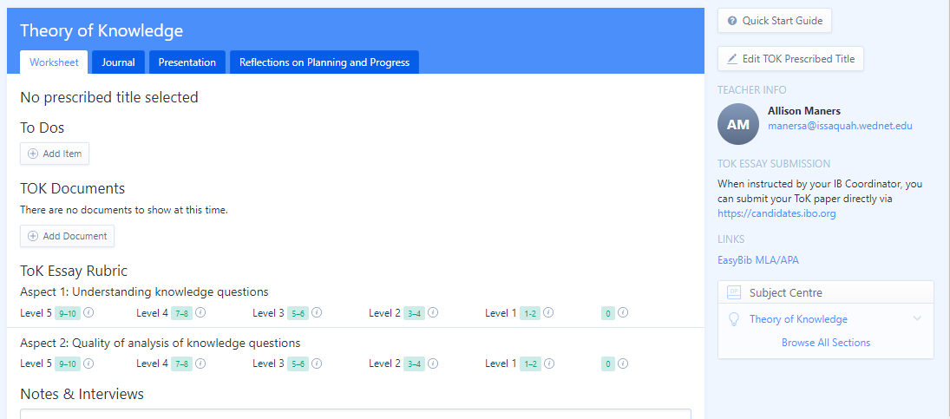

Slide 19
