Slide 1
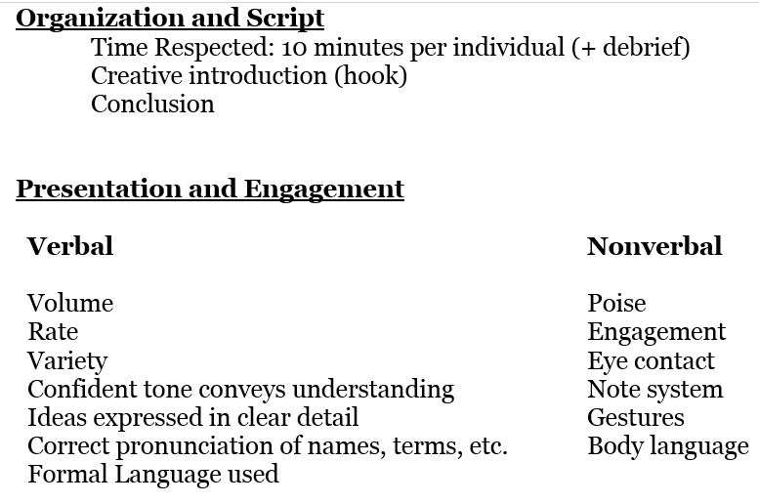
Kuhn Jigsaw mini presentations
During Our Next class - 20 mins creating a Ch 2 outline (Volunteers?) Then working on…
Mini Present (10 minutes) to your group Thursday, December 5
turn in an outline (combo of presentation & main points to cover-see picture below for directions) to turnitin.com before 8am Dec. 5th; But DO NOT Just READ the outline for your presentation
You choose the format, visuals, activities, etc. but try to include elements in the IA pictured right

Slide 2
Kuhn Jigsaw mini presentations
Keep in mind – What is your goal? Knowledge Questions? Development?
Present (10 minutes) to your group Thursday, December 5th (3-4 presentations) & Friday, December 6th (1-2 presentations)
turn in an outline to turnitin.com before 8am on thurs – 12/5
Will go in order of book as best you can with who is present – if absent, will have some more work to do, as it is the only way to get everyone the information
10 minutes a chapter-doesn’t matter if 1 or 2 presenters, you have 10 minutes to work with-you decide how to breakdown
If using technology, bring your own device
Read & have notes in Journal #19 for Ch 13 by Monday

