Slide 1
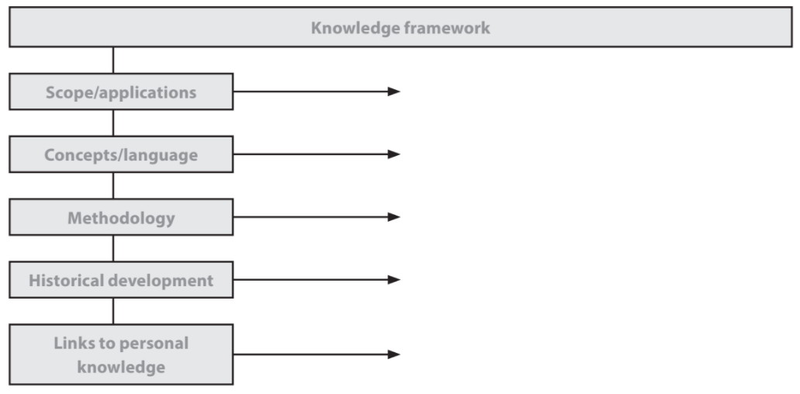
The Knowledge Framework

Slide 2
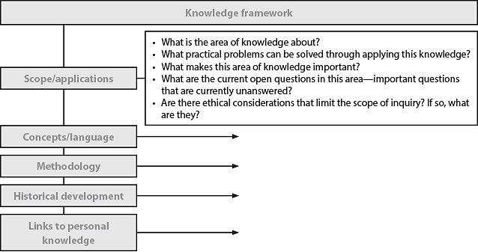
The Knowledge Framework

Slide 3
The Knowledge Framework

Slide 4
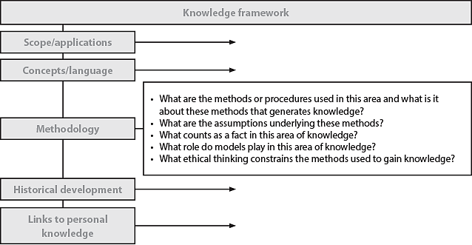
The Knowledge Framework

Slide 5
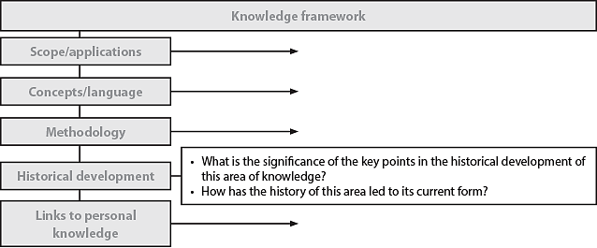
The Knowledge Framework

Slide 6
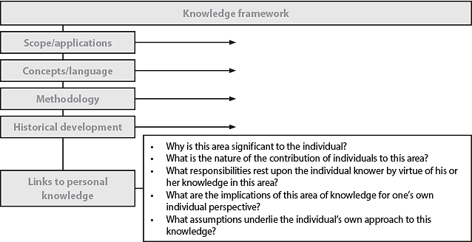
The Knowledge Framework

